Slide 1
FSA’s HRA’s & H S A’s
Florida Public Human Resource Association
2016 Conference
Presented by Mike Gelin, CEBS

Slide 2
Flexible Spending Accounts’s Health Reimbursement Arrangements and Health Savings Accounts
Today we will:
define the 3 types of tax arrangement accounts,
Discuss Advantages & Disadvantages and
Review a live case study to show the potential savings of implementing a HDHP with a Health Savings Account
The most popular account is the Flexible Spending Accont, the least utilized is the HRA and many view the H S A as the best and most flexible option now and in the future.

Slide 3
Flexible Spending Accounts – 3 Types
Healthcare, Dependent Care and Limited Purpose
Medical FSA – Allows employees to use pre-tax dollars to pay for eligible health care expenses for you, your spouse, and your eligible dependents.
Here’s how an FSA works. Money is set aside from your paycheck before taxes are taken out. You can then use your pre-tax FSA dollars to pay for eligible health care expenses throughout the plan year. You save money on expenses you’re already paying for, like doctors’ office visits, prescription drugs, and much more.

Slide 4
Flexible Spending Accounts
Medical FSA – Use It or Lose It !!!
The use it or lose it rule is the reason why employees do not participate in Healthcare FSA’s in large numbers. It’s very difficult to estimate healthcare expenses.
The IRS created this rule, which states that all money left in your FSA is forfeited after the plan year ends, or if applicable, after the run-out period. If your health
The unused portion of your health FSA cannot be paid to you in cash or other benefits, and you can’t transfer money between FSAs.

Slide 5
Flexible Spending Accounts
Medical FSA – Run Out Period & Grace Period
The run-out period gives you extra time to submit reimbursement requests for eligible expenses incurred during the plan year. If you visit the doctor in December (the last month of the plan year), you may submit a reimbursement request for that expense during the run-out period. You will be reimbursed from the funds left in your health FSA from the previous year.
A grace period extension gives you extra time to spend funds left in your account from the previous year. If you buy eyeglasses in January (the month after the plan year ends), you may use the remaining funds from the previous year to cover that expense. The grace period lasts two months and 15 days, so in this example, the grace period ends on March 15. And remember, not all FSA plans include this feature (see the SPD).
Employer may choose to change your cafeteria plan to allow you to carry over up to $500 of unused amounts remaining at the end of the plan year in a health FSA to be paid or reimbursed for qualified medical expenses incurred during the following plan year.

Slide 6
Flexible Spending Accounts – Carry over or Grace Period – Employer Chooses one or the other
Carryover – lets you carry over up to $500 of unused health FSA funds to the following plan year. (Your health FSA may have a maximum limit that is less.) This feature gives you more flexibility on how and when to use your health FSA funds.
Grace period extension – gives you extra time to incur eligible expenses and use funds remaining in your account after the plan year ends. The grace period begins on the first day of the following plan year and lasts two months and 15 days.

Slide 7
Flexible Spending Accounts – Eligible Expenses
What expenses are covered under a health FSA?
See IRS Publication 502 (2015), Medical and Dental Expenses
Only eligible expenses can be reimbursed under the FSA. These expenses are defined by IRS rules and your employer’s plan as defined in the SPD.
Eligible health FSA expenses are those that you pay for out of your pocket for medical care that covers you, your spouse, and eligible dependents. Generally, IRS rules state that medical care includes items and services that are meant to diagnose, cure, mitigate, treat, or prevent illness or disease. Transportation that is primarily for medical care is also included.
Common Expenses
Health plan deductible (the amount you pay before your plan starts paying a share of your costs)
Cost for doctor’s office visits and prescription drugs
Eligible dental care, including exams, X-rays, and cleanings
Eligible vision care, including exams, eyeglasses, contact lenses, and laser eye surgery

Slide 8
Flexible Spending Accounts – Contribution
What is the maximum amount employees can contribute to the FSA?
As a result of the Affordable Care Act, employee contributions have been capped for health FSA plans. The annual limit is $2,550, and you cannot contribute more than this amount. However, your plan may have an annual limit that is less.
Can my spouse also contribute to an FSA?
Yes, if your spouse is eligible to make contributions to a health FSA. Each spouse may contribute up to the $2,550 maximum limit to their own health FSA. This applies even if both spouses participate in the same health FSA plan sponsored by the same employer.

Slide 9
Flexible Spending Accounts – Limited Purpose
The limited purpose FSA works just like the standard FSA plan. However, eligible expenses are limited to qualifying dental and vision expenses for you, your spouse, and your eligible dependents.
Employees enrolled in a qualified High Deductible Health plan with an H S A can contribute up to $2,550 to a limited purpose FSA for dental and vision expenses.
Dental and vision expenses can be paid with and H S A
Employees enrolled in a qualified HDHP plan cannot pay for medical expenses with a limited purpose flexible spending account.

Slide 10
Flexible Spending Accounts – Survey Data
A 2014 survey conducted by Aflac, found that 22% of employees are not very or not at all knowledgeable about FSAs.
In companies with 500 employees or more, 85% of companies said they offer a FSA while 62% of small businesses with 50 to 500 employees also provide them, according to a survey conducted by Mercer
According to the Bureau of Labor Statistics National Compensation Survey, 39% of all workers in 2010 had access to a health care flexible spending account.

Slide 11
Flexible Spending Accounts – Wageworks Survey
86% of survey respondents had at least one misconception about FSAs
One in five respondents (21%) did not know that FSA contributions are not subject to income and social security taxes
One quarter (26%) didn’t know that you cannot change your election during the year without a qualifying event (such as the birth of a child)
78% could not identify which expenses qualified for reimbursement by an FSA, including: over-the-counter medications, insurance co-payments and contact lenses and solution
88% of those enrolled in an FSA identified savings as a reason for signing up
45% of those enrolled in an FSA said they signed up to have an available source of funds available for health care expenses
94% of participants felt their FSA contribution was “just right” or “too low”
Only 6% thought their contribution was “too high”

Slide 12
Dependent Care Flexible Spending Accounts

Slide 13
Dependent Care Flexible Spending Account Plan
A Dependent Care FSA allows employees to use pretax dollars to pay for eligible expenses related to care for your child, disabled spouse, elderly parent, or other dependent who is physically or mentally incapable of self-care.
The alternative to using a Dependent Care FSA is to take a dependent care tax credit when you file your federal income taxes. Your preferred method depends on your income, number of eligible dependents, and other factors; however, Dependent Care FSAs usually provide the greater tax advantage for most people, especially as income increases.

Slide 14
Dependent FSA - Eligibility
Eligibility Rules for Dependent Care FSAs Your qualified dependents for a Dependent Care FSA may include
Your child(ren) under age 13.
Dependents of any age who are mentally or physically incapable of caring for themselves, and whom you claim as a dependent on your federal income tax return.
An adult may qualify as your dependent if you provide more than half that person’s maintenance costs during the year.

Slide 15
Dependent FSA - Contributions
How Much You Can Contribute?
The minimum and maximum amounts you can contribute to the Dependent Care FSA are set by your employer, although the maximum allowed by the IRS is $5,000 a year for individuals or married couples filing jointly, or $2,500 for a married person filing separately.
Please note: married couples have a combined $5,000 limit, even if each has access to a separate FSA through his or her employer.

Slide 16
Dependent FSA – Eligible Expenses
Expenses for care of a qualified dependent are only eligible if the care enables you (or you and your spouse) to work, look for work, or go to school full-time. If your spouse is a stay-at-home mom or dad, you cannot participate in Dependent care FSAs.
Eligible expenses include:
Fees for licensed day care or adult care facilities.
Amounts paid for services (including babysitters or nursery school) – provided in or outside of your home – for the care of a qualified dependent necessary to allow you and your spouse to work, look for work, or attend school full-time.
Placement fees for a dependent care provider, such as an au pair.
Summer day camp for children under age 13 qualifies if attendance allows you and your spouse to work, look for work, or for your spouse to attend school full-time.
Before and after school care programs for dependents under age 13.
Payment to a relative (age 19 or older who is not your dependent) who cares for your qualified dependent.
Payment to a housekeeper whose duties also include dependent day care.

Slide 17
Dependent FSA – Additional Items
Unlike Health Care FSAs, with Dependent Care FSAs you can be reimbursed only for expenses that fall within your current account balance, so you may have to wait until the account balance builds to sufficiently cover a large claim early in the year.

Slide 18
Flexible Spending Account Summary
There are (3) types of flexible spending accounting plans:
Healthcare FSA
Dependent Care FSA
Limited Purpose FSA
Employers can allow employees to set aside up to $2,550 in pre tax dollars to cover healthcare expenses or set a lower maximum amount
The IRS allows employees to set aside up to $5,000 in pre tax dollars for a dependent care account
Participation rates remain relatively low although the program has been available for 40 years
The use it or lose it provision of the health FSA still worries employees despite the option of a rollover provision or 2 month 15 day extension
Limited over the counter medicines are covered only as prescribed

Slide 19
Health Reimbursement Arrangement
(HRA’s)

Slide 20
Health Reimbursement Account – Definition
What is a Health Reimbursement Arrangement?
A Health Reimbursement Arrangement (HRA), commonly referred to as a Health Reimbursement Account, is an IRS approved, employer-funded, tax-advantaged employer health benefit plan that reimburses employees for out-of-pocket medical expenses and individual health insurance premiums.
Unlike FSA’s or H S A’s, HRA dollars are notional or stated dollars only. They are not hard or committed dollars. This is more advantages to the employer than it is to the employee which can make it a harder sell.

Slide 21
Health Reimbursement Account – Advantages
What are the advantages of an HRA?
Health reimbursement arrangements have some benefits that can help you save in health care costs.
Affordability: Premiums for health insurance plans offered with an HRA are generally less per month than other plans.
Employer contributions: Your employer fully funds your HRA with no contributions from you.
Potential tax savings: Money that goes in and out of these accounts can be tax exempt or tax deductible.

Slide 22
Health Reimbursement Account – Advantages
What are the advantages of an HRA?
Health reimbursement arrangements have some benefits that can help you save in health care costs.
Affordability: Premiums for health insurance plans offered with an HRA are generally less per month than other plans.
Employer contributions: Your employer fully funds your HRA with no contributions from you.
Potential tax savings: Money that goes in and out of these accounts can be tax exempt or tax deductible.

Slide 23
Health Savings Account
(H S A’s)

Slide 24
What is a CONSUMER DRIVEN HEALTH PLAN (CDHP)? (Basic Definition)
Consumer Driven Health Plans combine a tax advantaged and funded spending or savings account with a qualified high deductible insurance policy. Typically these account-based plans involve either a Health Savings Account (HSA) or a Health Reimbursement Account (HRA). The companion insurance policies for HSAs must meet the regulatory definition of a High Deductible Health Plan (HDHP).

Slide 25
What is a CONSUMER DRIVEN HEALTH PLAN (CDHP)? - Aetna Definition
A benefits plan that gives you more purchasing power. You can visit any licensed provider (in and out of network), and you are given Medical and Dental Funds to help pay for services that are covered under your Plan. You pay nothing for covered services until you use up the funds. You can stretch your funds by seeking the most cost-effective care. When you use Aetna participating providers for covered services, you get the advantage of Aetna's negotiated rates.

Slide 26
What is a CONSUMER DRIVEN HEALTH PLAN (CDHP)? – Florida Blue Definition
An HSA is a tax-deductible savings account that is used to help pay for current or future qualified medical expenses which are not reimbursed through health insurance or any other health reimbursement source (i.e., deductibles, coinsurance as well as vision and dental services). An HSA allows tax-free contributions and withdrawals, similar to an Individual Retirement Account (IRA), except it's for medical expenses. And, any remaining balance rolls over year-to-year and is theirs to keep, regardless of job changes or retirement. In order to be eligible for an HSA, they must be enrolled in a "qualified high-deductible health benefit plan" as defined by the IRS.

Slide 27
What is a CONSUMER DRIVEN HEALTH PLAN (CDHP)? – United Healthcare Definition
The HSA combines the flexibility of a medical insurance plan with the cost effectiveness of a tax-advantaged savings account.
HSAs help your employees play a larger role in their own health care by letting them:
Access health coverage in the form of an Annual Deductible Health Plan
Enjoy 100 percent coverage for in-network preventive care services
Choose from a variety of cost-effective health and wellness services
Opt for a tax-advantaged health savings account with multiple trustee and investment choices
Use our innovative phone- and web-based health management tools

Slide 28
Health Savings Account vs. Health Reimbursement Account

Slide 29
Contribution and Out-of-Pocket Limits for Health Savings Accounts and High-Deductible Health Plans
For 2017
HSA contribution limit (employer + employee)
Self Only | $3,400
Family | $6,750
HSA catch-up contributions (age 55 or older)* | $1,000
HDHP minimum deductibles
Self Only | $1,300
Family | $2,600
HDHP maximum out-of-pocket amounts (deductibles, co-payments and other amounts, but not premiums)
Self Only | $1,300
Family | $6,550

Slide 30
Municipalities with a CDHP?
City of Fort Lauderdale – CDHP paired with an HRA
City of Delray Beach – CDHP paired with an HRA
City of Oakland Park – CDHP with H S A
City of Plantation – Plans to add for 2017
City of Sunrise – Traditional HMO, POS or PPO plans
City of Coral Springs – Traditional HMO, POS or PPO plans
City of Pompano Beach – Traditional HMO, POS or PPO plans
Each of these cities have at least 800 employees.

Slide 31
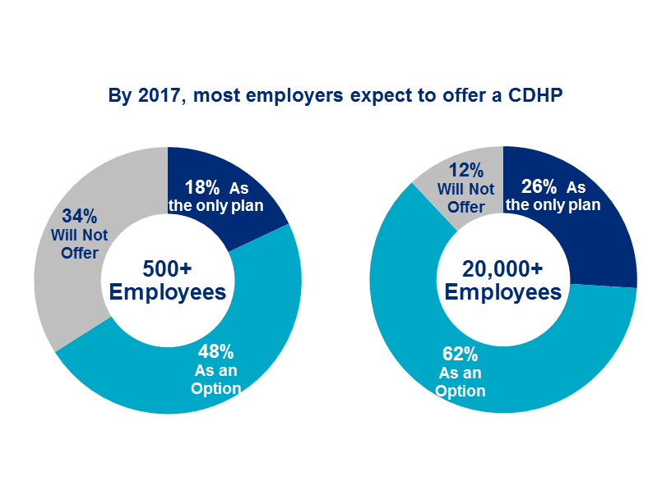
National CDHP Prevalence
Source: National Survey of Employer­ Sponsored Health Plans

Slide 32
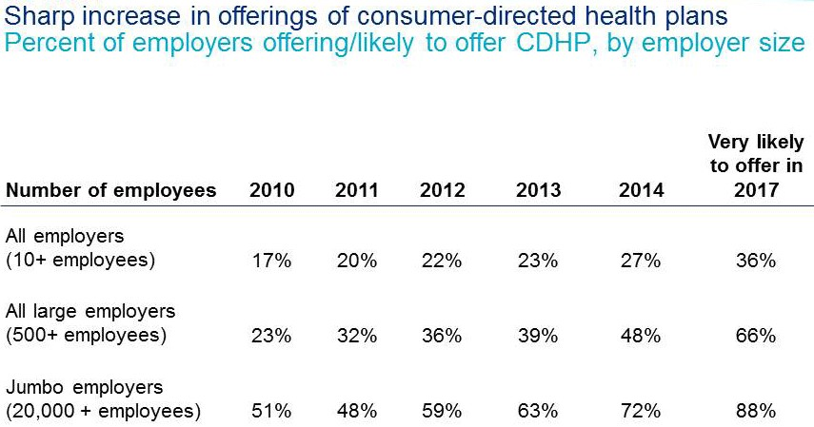
CDHP Trends
Source: National Survey of Employer­ Sponsored Health Plans

Slide 33
CDHP Support Programs
 | Large employers (500 or more employees) | Jumbo employers (20,000 or more employees)
Transparency tools | 77% | 86%
Telehealth services | 18% | 34%
Voluntary benefits offered specifically to fill gaps in employer-paid benefits | 77% | 74%
Source: National Survey of Employer­ Sponsored Health Plans

Slide 34
CDHP Support Programs – Transparency Tools
myHealthcare Cost Estimator: Providing Cost Transparency for a More Informed Health Care Consumer
UnitedHealthcare's transparency tools are designed to assist members in making informed decisions regarding treatment options, providers, and service locations. Cost estimates are displayed for in-network hospitals and physicians.
Medical Procedure by Facility Cost Tool
Our Medical Procedure by Facility Cost tool allows members to review and compare health care costs for a specific procedure, based on the type of setting in which the procedure is performed. The tool includes higher-volume elective services for which most members will be more likely to “shop.” This tool is currently available in 50 markets.±

Slide 35
CDHP Support Programs – Transparency Tools
Florida Blue
Care Comparison offers transparency in health care
Care Comparison is a health care-comparison tool designed to help members evaluate the total estimated cost of approximately 40 specific medical procedures at hospitals, ambulatory surgery centers or imaging centers.
The Care Comparison data is based on one year’s worth of BCBSF claims and will be updated monthly. Hospital quality information will also be provided, based on publicly reported data from the Agency for Health Care Administration (AHCA), Centers for Medicare & Medicaid Services (CMS), WebMD® and The Leapfrog Group

Slide 36
CDHP Support Programs – Transparency Tools
CIGNA Cost Care Estimator - online service that provides accurate prices for more than 200 common medical procedures and quality information on doctors and hospitals to its health plan customers nationwide.
The website features physician and health facility quality and pricing information that’s personalized to an individual’s health plan in the newly redesigned “Find Doctors and Services” search engine. The new price estimates cover more than 200 common procedures – from delivering babies to knee replacement surgery – that represent 80 percent of Cigna's medical claims.

Slide 37
CDHP Support Programs – Transparency Tools
Castlight Health - Castlight offers a health benefits platform that engages employees to make better healthcare decisions and enables employers to communicate and evaluate their benefit programs. Some of Castlight's customers include Kraft Foods Group, Life Technologies, Honeywell, CVS Caremark, and Liberty Mutual.
Healthcare Blue Book - Healthcare Blue Book also uses an algorithm to not only offer various prices for services, but also provides a "fair price" that service.
HealthinReach is a free online platform that aims to help patients find the low prices from dentists and doctors and book appointments online. The company said it offers descriptions and prices for nearly 50,000 specific procedures and has so far seen 3 million users on the website.

Slide 38
CDHP Support Programs – Transparency Tools
GoodRx offers cost transparency about medications instead of medical services. The company partnered with Aetna in June of 2012 to provide data to developers looking to build apps with APIs managed by Aetna.
To use the app, people enter in the name of the prescription they plan to purchase along with their zip code. The app then shows a list and map of prices for the brand name and generic versions of the drug the user is seeking — both from local brick-and-mortar pharmacies as well as mail order ones. The app also offers refill reminders and price alerts.

Slide 39
CDHP Support Programs – Telehealth
Telehealth encompasses a broad variety of technologies and tactics to deliver virtual medical, health, and education services. Telehealth is not a specific service, but a collection of means to enhance care and education delivery.
Live video (synchronous): Live, two-way interaction between a person (patient, caregiver, or provider) and a provider using audiovisual telecommunications technology.
Store-and-forward (asynchronous): Transmission of recorded health history (for example, pre-recorded videos and digital images such as x-rays and photos) through a secure electronic communications system to a practitioner, usually a specialist, who uses the information to evaluate the case or render a service outside of a real-time or live interaction.

Slide 40
CDHP Support Programs – Telehealth
Telehealth encompasses a broad variety of technologies and tactics to deliver virtual medical, health, and education services. Telehealth is not a specific service, but a collection of means to enhance care and education delivery.
Remote patient monitoring (RPM): Personal health and medical data collection from an individual in one location via electronic communication technologies, which is transmitted to a provider (sometimes via a data processing service) in a different location for use in care and related support. This type of service allows a provider to continue to track healthcare data for a patient once released to home or a care facility, reducing readmission rates.
Mobile health (mHealth): Health care and public health practice and education supported by mobile communication devices such as cell phones, tablet computers, and PDAs. Applications can range from targeted text messages that promote healthy behavior to wide-scale alerts about disease outbreaks, to name a few examples.

Slide 41
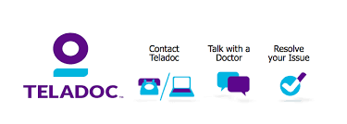
CDHP Support Programs – Telehealth
Telehealth encompasses a broad variety of technologies and tactics to deliver virtual medical, health, and education services. Telehealth is not a specific service, but a collection of means to enhance care and education delivery.
Teladoc
(1) Request a visit with a doctor 24 hours a day, 365 days a year, by web, phone, or mobile app. Want to see the doctor? Choose “video” as the method for your visit. Feeling camera shy? Choose “phone.” Got a busy schedule? Select a time that’s best for you by choosing “schedule” instead of “as soon as possible.”
(2) Talk to the doctor. Take as much time as you need…. there’s no limit!
(3) If medically necessary, a prescription will be sent to thepharmacy of your choice.

Slide 42
CDHP Support Programs – Telehealth
MDLIVE’s industry-leading HIPAA and PHI-compliant, cloud-based platform helps consumers, health plans, health systems and self-insured employers obtain better, faster care that’s more convenient than visiting a doctor’s office and far more cost-effective than going to the ER or Urgent Care for routine ailments.
Why Telehealth
Convenient Care
More efficient
Greater Flexibility – No long drives to the office or wait times
Fewer Missed Appointments
More Flexible Hours – available 24/7

Slide 43
CDHP Support Programs – Voluntary Benefits
Voluntary benefits, often referred to as Worksite Marketing products can be any type of additional benefit that is added to an employer's menu of benefit options. These benefits may be provided through insurance products that can be classified as either core products or ancillary products.
They can fill in the gaps of a limited employee benefits package
Pre-taxed dollars can be used to pay for these plans
Encourages preventive care
Pays a cash benefit directly to employees or can be assigned to a provider
Provides employees with a strong sense of financial security in case of a catastrophe

Slide 44
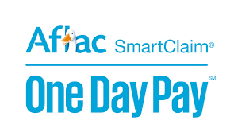
CDHP Support Programs – Voluntary Benefits
Total voluntary/worksite sales for 2014 are estimated at $6.89 billion, up from $6.644 billion in 2013, Eastbridge Consulting Group said. The data comes from the group's annual U.S. Worksite/Voluntary Sales Report, which analyzes data from more than 60 carriers.
Accident Insurance
Hospital Indemnity
Critical Illness
Cancer Insurance

Slide 45
The Healthcare Conundrum
QUALITY/PLAN DESIGN
PRICE
NETWORK

Slide 46
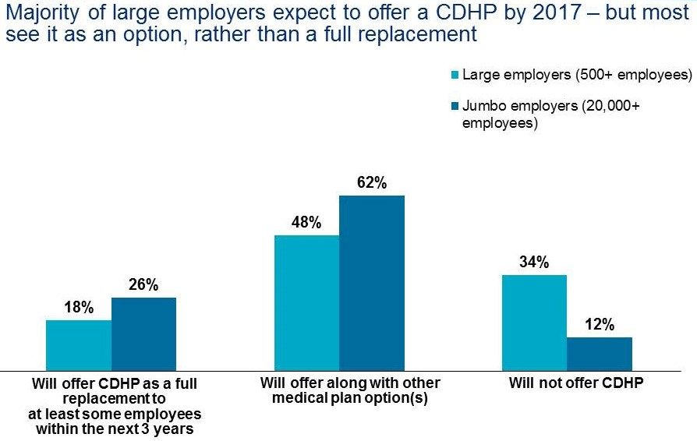
CDHP Option or Full Replacement
Source: National Survey of Employer­ Sponsored Health Plans

Slide 47
Advantages of a Health Savings Account
You can pay for healthcare expenditures with tax-free money
Interest earned on your HAS account is tax-free
You own your health savings account
Benefits of the HSA account can’t be lost
A health savings account is a good strategy for retirement planning
You become a more informed healthcare consumer.
An HSA can reduce stress
HSAs come with a significant premium savings over traditional health insurance plans
An HSA can be used to pay for any medically necessary service
You can use it as an emergency savings account

Slide 48
Advantages of a Health Savings Account
You can pay for healthcare expenditures with tax-free money.
The money deposited in this account is tax-free!
When you use your HSA debit card to pay for your medical expenses and deductibles, you are paying for it in pre-tax dollars
Keep records of all of those expenditures with your annual tax filing in case you ever get audited by the IRS. Those receipts are the only acceptable proof to the IRS that you spent the tax-free funds on approved products and services.

Slide 49
Advantages of a Health Savings Account
2. Interest earned on your H S A account is tax-free
The interest earned on the money in an HSA is tax-free.
The interest stays in your account until you are ready to use it to pay for your healthcare expenses.

Slide 50
Advantages of a Health Savings Account
3. You own your health savings account.
You own the money in your HSA account…both your contribution and the employer contribution
It doesn’t belong to the insurance company or your employer and can’t be raided for any other reason by anyone.
HSA accounts do not have to be used in the same year as the contributions.

Slide 51
Advantages of a Health Savings Account
4. Benefits of the HSA account can’t be lost.
If you lose your health insurance, the account stays with you. It cannot be taken away if you change employers. This is not a ‘Use it or Lose it’ benefit!
The money just rolls over and stays with you for whenever you need it in the future.
Upon your death, the funds are yours and will be distributed to your beneficiary.

Slide 52
Advantages of a Health Savings Account
5. A health savings account is a good strategy for retirement planning.
HSA rolls over year after year and there are no limits to how much you can accumulate (via investments) in the account so the HSA account is a good tool for retirement
After the age of 65, you can withdraw funds from your HSA account penalty-free for any purpose. You will pay income tax on the withdrawal if it is not used to pay for health care, but that tax rate is likely to be lower in your retirement years when your income is lower
You can continue to withdraw the money from your HSA account tax-free to pay for medically necessary expenses.

Slide 53
Advantages of a Health Savings Account
6. You become a more informed healthcare consumer.
To qualify for the benefits of an H S A, you must be enrolled in a qualified High Deductible Health Plans (HDHPs)
As an enrollee in an HDHP, you will be paying the full cost of your care (using the tax-free dollars in your HSA account) until your deductible is met.
The goal is to ensure consumers are knowledgeable about the true cost of care so they become better consumers.
Insurance carrier websites have robust tools that will help you shop around for providers allowing you to evaluate pricing and quality of care

Slide 54
Advantages of a Health Savings Account
7. HSAs come with a significant premium savings over traditional health insurance plans.
H S A qualified health plans have higher deductibles than traditional plans, but they come with much lower premiums.
Based on premium savings alone, some HSA owners see 20–40% savings in the cost of maintaining insurance coverage each year.

Slide 55
Advantages of a Health Savings Account
8. An HSA can be used to pay for any medically necessary service.
You can use your H S A dollars to cover the cost of:
Dental Services
Vision Services – glasses, contacts and eye surgery
Prescription drugs
Non drug over the counter medical items such as band aids etc.
Even if your group insurance program does not cover these items, you can use your HSA debit card to pay for them with pre-tax dollars.

Slide 56
Advantages of a Health Savings Account
9. You can use it as an emergency savings account.
Some HSA owners pay all their eligible medical expenses out-of-pocket and let the HSA account grow a tax-deferred emergency fund. They keep the receipts and if next year the owner needs emergency cash, he can reimburse himself for the previous year’s expenses up to the total of the receipts and owe no tax.

Slide 57
Live Case Study on CDHP

Slide 58
Basic details:
Company offers a traditional health plan and an HDHP Plan with an H S A
Covers about 70% of the total cost of insurance across all tier levels
Provides significant contributions to the Health Savings Account
Enrollment in H S A plan has remained steady since first implemented
Most are either highly paid or young and healthy
There is no incentive to drive employees into HDHP other than standard education during open enrollment – Its offered as an option with no pressure to enroll in HDHP

Slide 59
PLAN DESIGN COMPARISON Traditional PPO Plan

Slide 60
PLAN DESIGN COMPARISON - HDHP

Slide 61
PLAN DESIGN COMPARISON – Traditional vs. HDHP

Slide 62
Rate and Contribution Comparison

Slide 63
H S A Contributions

Slide 64
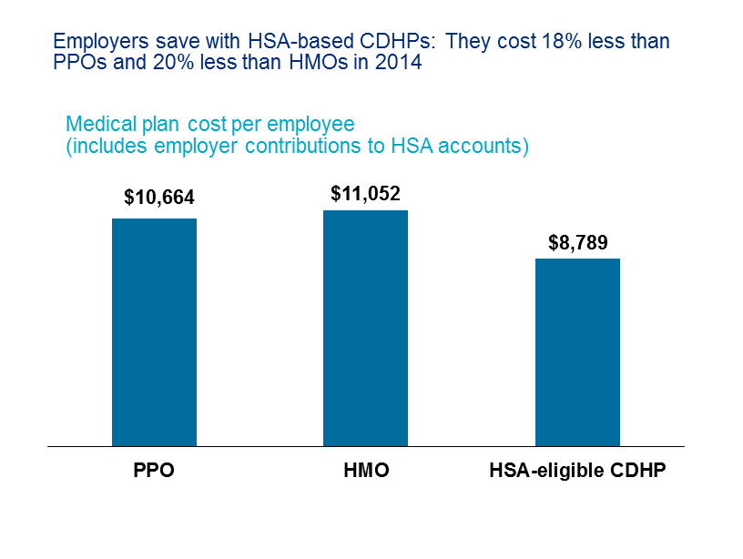
National Cost per employee: CDHP vs. Traditional
Source: National Survey of Employer­ Sponsored Health Plans
Notes:
Nationally, this is what the per employee per year costs are for a CDHP compared to more traditional plans. Please note these are 2014 numbers.
As you can see, the savings are significant.

Slide 65
Cost Comparison Traditional PPO vs. CDHP
Does this theory of an 18 – 20% cost differential hold true in this case.

Slide 66
True Cost of HDHP Plan
What is the true cost or total “premium” for the health insurance when factoring contributions to the health savings account.

Slide 67
Cost Scenario for Employees
How does the cost to employees compare with the traditional plan versus the HDHP program?

Slide 68
How much is saved by offering the HDHP Plan?

Slide 69
Questions????
Questions for you….
Are you prepared to offer a High Deductible Health Plan with an H S A account to your employees?
Can you convince the finance and or budget department to make the investment?
How much would you contribute to the H S A?
Do you think this is an easy sell to the police and fire union? (I think so)

Slide 70
Thanks for your time and attention!!!
Mike Gelin, CEBS

