Slide 1
Conflict Resolution
Presented by David Alba
davidalba007@gmail.com

Slide 2
The more I deal with people,
the more I like…
…My dog.
Notes:
EQ article - stress that unlike IQ the good news of EQ is that it can be learned.

Slide 3
EQ:
The ability to use your emotions to form an optimal relationship with yourself and others.
EQ is a better predictor of success
than IQ!

Slide 4
Core Elements of EQ
Self-awareness
Self-management
Social awareness
Relationship management

Slide 5
Conflict in Communication
Sender
Receiver

Slide 6
2. Be Intentional
Intentional Verbals – say what you mean to say (carefully choose your words)
Unintentional Verbals – words can be barriers or bridges
Notes:
Intentional Verbals - choose words to build relationships [Kerry - bus duty - absolutely] [FQ letter]
I’d be happy to I’ll check on that personally
Don’t be surprised that if you start using R building words your people will, too. - More caught than taught.
We speak what we hear. Movie examples: Go ahead.. I want the truth… I’ll… [Son and trash]
Intentional Non-verbals - look and sound the way you intend to look and sound (James Bond)
Body language, posture, facial expression, voice tone, eye contact
Unintentional Verbals - have you ever said something and the minute you said it… Don’t engage in unedited speaking.
Profanity Freakin’ Sucks Double Negative - don’t have no, don’t mean nothing Axe for Ask Pacific for Specific Unless the copier has no money… Darlin’ Don’t air dirty laundry
Unintentional Non-verbals - body language Voice tone [Jodi]
When the verbal and the non-verbal disagree what do people believe? Non-verbal every time.
I have a quick clip of someone who’s being very intentional. I think he knows exactly what he wants to say. [Jack - Few Good Men clip]

Slide 7
2. Be Intentional
Intentional Non-verbals – look/sound the way you intend to look/sound
Unintentional Non-verbals – people believe the non-verbals, voice tone and body lang.
Notes:
Intentional Verbals - choose words to build relationships [Kerry - bus duty - absolutely] [FQ letter]
I’d be happy to I’ll check on that personally
Don’t be surprised that if you start using R building words your people will, too. - More caught than taught.
We speak what we hear. Movie examples: Go ahead.. I want the truth… I’ll… [Son and trash]
Intentional Non-verbals - look and sound the way you intend to look and sound (James Bond)
Body language, posture, facial expression, voice tone, eye contact
Unintentional Verbals - have you ever said something and the minute you said it… Don’t engage in unedited speaking.
Profanity Freakin’ Sucks Double Negative - don’t have no, don’t mean nothing Axe for Ask Pacific for Specific Unless the copier has no money… Darlin’ Don’t air dirty laundry
Unintentional Non-verbals - body language Voice tone [Jodi]
When the verbal and the non-verbal disagree what do people believe? Non-verbal every time.
I have a quick clip of someone who’s being very intentional. I think he knows exactly what he wants to say. [Jack - Few Good Men clip]

Slide 8
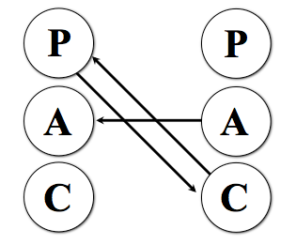
Respond, Don’t React
P
P
A
A
Notes:
This is known as transactional analysis.
From the time we are very young, we communicate from three ego states, the parent the adult and the child.
Parent - talks down - superior to inferior
Adults share information on and equal level
Child reacts emotionally
When tend to respond based on how we are approached
Illustrate parent child.
If someone talks down to me as if I were a child, do I have to respond emotionally? No, in fact if I respond as an adult, I can rise the transaction level up. [Next slide]

Slide 9
Professionals act professionally
Whether they feel like it or not.

Slide 10
Handling Anger
L isten
E mpathize
A pologize (if appropriate)
D o something or direct to someone who can

Slide 11
Saying No
N eutralize through a positive beginning
I mmediately empathize
C ourteously explain
E mphasize your desire to help
Notes:
Let’s see how empathetic these folks are [Buh-bye]

Slide 12
Intercept Dissension
Build positives to lessen the impact
Refuse to participate in unproductive anger
Act to resolve issues quickly
Don’t assume motive
Notes:
First of all I want to maintain the kind of relationship that allows me to deal effectively with disagreement. Explain concept of emotional bank accounts. When there are a lot of deposits, we can ride through dissention just fine because we give each other the benefit of the doubt.
Corrie Ten-Boom - I distinctly remember forgetting that. Have you ever been so angry that you felt that you just had to demonstrate just how angry you were - even when you know that nothing productive can come from the display of anger. Good communicators can deal with their emotion internally and work on relationship not retribution. Story of Ledfords.
Once a rift has occurred don’t let it linger. What does fester mean? Right it gets worse and worse. Seek to resolve the matter quickly so that it doesn’t fester.
Sometimes the most loving thing can be holding people accountable and pushing them to be their best. Those of you with teenagers know that and sometimes it’s true with adults as well. Kind of a tough love. [Men of Honor]
Managing interpersonal relationships can be challenging, people are complicated - but it’s those relationships both at work and personal that can make life so rewarding. Using these tools I wish you the best in managing your interpersonal relationships.

Slide 13
Relationship Bank Accounts
Deposits + | Withdrawals –

Slide 14
Definition
Conflict: a violation of expectations resulting in negative reactions.

Slide 15
Expectations
Conflict: a violation of expectations resulting in negative reactions.
Expectations regarding:
What is to be done
When it should be done
How it is to be done

Slide 16
Expectations
Most people do not knowingly violate the expectations of those with whom they must collaborate.
Many of our expectations are implicit; we may not know we have the expectation until it is violated.

Slide 17
Typical Workplace Violations
Leader to employee:
Micromanaging
Making decisions that affect employees without asking for input
Letting some employees shirk their duties without negative consequences
Not giving praise or recognition
Not recognizing employee has life outside of work that occasionally takes priority

Slide 18
Typical Workplace Violations
Employee to Leader
Missing or being late to work
Not outwardly demonstrating commitment & support for leader’s agenda and priorities
Not completing tasks/assignments in a timely manner
Not letting the leader know when there are problems so he/she is not surprised

Slide 19
Typical Workplace Violations
Employee to Employee:
Competing for or not sharing resources
Not sharing credit for a job well done
Not responding to voice mails or emails in a timely manner
Gracious non-compliance
Not behaving in a courteous manner (all levels)

Slide 20
When It’s Time to Confront
Control your emotions
Focus on the issue and not the individual
Use effective phrases
Help me understand why…
I feel angry/upset that...
May I give you some feedback?

Slide 21
When Being Confronted
Control your emotions
Don’t be defensive
Use effective phrases
You’re right. I should have ___________ / should not have_______. Thank you for pointing that out. I’ll work on that. (Then work on that.)
Thank you for pointing that out. May I think about it and get back with you?
I wasn’t aware of that. Can you give me an example so that I know what to avoid next time?

Slide 22
Steps to Resolving Conflict
Control your emotions.
Determine if you should confront or let it go.
If it would be healthy to confront, ask the person if they have time to talk.
Tell the person how you feel and why using effective phrases.
Focus on the issue and not the individual.
Listen. Listen. Listen. (Watch your body language.)
Calmly discuss/negotiate alternatives/compromises for resolving the conflict.
If the conversation becomes heated you may need to resume it later.

Slide 23
Sometimes
Sometimes conflict is really just being annoyed, and sometimes I have to be the bigger person (maturity).

Slide 24
Key Strategy
Don’t offend
Don’t be offended.

Slide 25
Key Strategy
There are some things, I just don’t have to have an opinion on!

Slide 26
Key Strategy
Don’t assume motive.

Slide 27
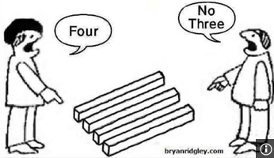
Key Strategy
Let’s agree to disagree, agreeably.

Slide 28
Seeking and Finding
People generally find what they are looking for.
If you look for the negative you’ll find it
If you look for the positive you’ll find it
Being negative or being positive is a choice

Slide 29
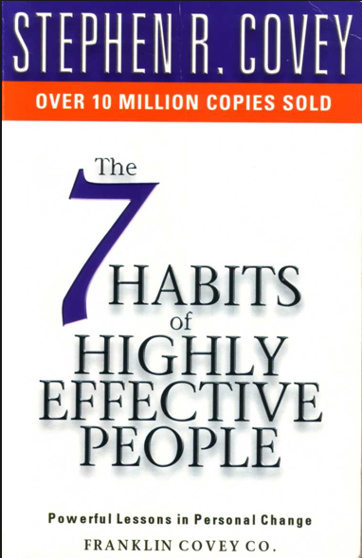
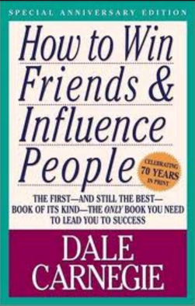
Thank You
My name is David Alba – davidalba007@gmail.com
If any of my stories aren’t true - they should’ve been!
Three books I recommend:

