Slide 1
FLSA Overview
Gary Wheeler
Constangy, Brooks, Smith & Prophete, LLP
904-356-8900
gwheeler@constangy.com

Slide 2
Roadmap for Today
2015: A Wage & Hour Retrospective
The Final Rule
Preparing for Implementation
Review Timekeeping Procedures
Legal Attempts to Stop Regulations from Being Implemented

Slide 3
Roadmap for Today
Interns/ Volunteers
Independent Contractors v. Employees

Slide 4
2015: A Wage & Hour Retrospective

Slide 5
Looking Back at 2015
More than 8,700 FLSA lawsuits (7,964 in 2014)
New York and Florida had most cases filed
Since 2000, there has been a 454% increase in suits
DOL budget request: 815 more full-time employees
Low-wage earners
White collar exemptions

Slide 6
Looking Back at 2015

Slide 7
Job Types Targeted by Plaintiffs’ Attorneys
IT workers
Service technicians
Installers
Sales representatives
Nurses and healthcare workers
Accountants
Assistant Managers
Tipped employees
Oil and gas field workers
Call center workers
Personal bankers and mortgage brokers
Retail employees
Customer Service Representatives
Analysts

Slide 8
The Final Rule

Slide 9
The White Collar Exemptions
Sections 13(a)(1) and (17) of the FLSA set forth the so-called “White Collar Exemptions” to the overtime provisions:
Administrative
Executive
Professional (Learned, Creative, Teaching)
Outside Sales
Computer Professional

Slide 10
Criteria for White Collar Exemptions
29 CFR Part 541
In general, exempt employees must:
Be paid on a salary basis;
Be paid a certain minimum salary; and
Meet certain requirements as to their job duties.

Slide 11
DOL Final Rule
Proposed Rule published on July 6, 2015
Revises 29 CFR Part 541
Only substantive changes are to the fixed minimum salary
Finalized and released May 18, 2016
Effective December 1, 2016

Slide 12
Who Benefits from New Overtime Rule according to DOL?

Slide 13
Fixed Minimum Salary
The fixed minimum salary only applies to:
Administrative Exemption
Executive Exemption
Professional Exemption (with exceptions)
Computer Professional Exemption (for employees who are not paid hourly at a rate of at least $27.63 per hour)

Slide 14
Fixed Minimum Salary
The fixed minimum salary does not apply to:
Outside Sales Exemption
Computer Professional Exemption (for employees who are paid hourly at a rate of at least $27.63 per hour)
Select employees who qualify for the Professional Exemption, such as:
Attorneys
Doctors
Teachers

Slide 15
Fixed Minimum Salary (New)
New fixed minimum salary
Set to 40th percentile of earnings of full time salaried workers from Bureau of Labor Statistics Index
Minimum salary effective December 1, 2016: $47,476 annually (or $913 per week)
Up from current $23,660 (or $455 per week)
Highly compensated employee increase from $100,000 to $134,004
Up from current $100,000
Automatically updated every 3 years

Slide 16
Bonuses and Commissions
Nondiscretionary bonuses, incentive payments and commissions, paid at least quarterly, can satisfy up to 10 % of the minimum salary requirement

Slide 17
How the Bonus Payments Work
Weekly salary level: $913.00
90% of weekly salary level: $821.70
At the end of a quarter, $821.70 plus all bonuses and commissions received must equal or exceed 1/4 of the annual salary (1/4 of $47,476) or $11,869
If the compensation received does not meet that amount at the end of the quarter, the employer must make up the difference in the first pay period of the next quarter

Slide 18
Preparing for Implementation
A wider lens on workplace law

Slide 19
Addressing Increased Salary Requirements
Review all exempt employees whose salaries are below $47,476
Decide whether or not to reclassify as non-exempt
Decide how to compensate for overtime

Slide 20
Implementing the New 541 Regs
Raise Salary or Reclassify
If reclassified, should employees be paid hourly or salaried non-exempt?

Slide 21
Things to Consider
Impact on benefits, vacation/PTO accrual or bonuses
Employee relations impact
Non-exempt employee feels less “valued”
Resents reclassification, time-recording obligations
Looks at what competitors are doing

Slide 22
Economic Issues in Raising Salaries
Calculate the cost of increasing a salary to $47,476
Remember, any salary below $43,160 will have to be raised at least 10%
Every THREE years thereafter, the salary will have to be raised again

Slide 23
Another Issue Involved in Reclassifying Employees From Exempt to Nonexempt
Determining an Hourly and
Overtime Rate

Slide 24
Determining an Overtime Rate
Do you divide weekly salary by 40?
Do you use the “cost neutral” formula?
Do you use the fluctuating workweek method?

Slide 25
Example No. 1
Weekly Salary: $800
Weekly Hours Worked: 50 Hours
Determining overtime due:
Method No. 1: Assume salary was for 40 hours.
OT Due = $800/40 = $20 x 1.5 x 10 = $300

Slide 26
Cost-Neutral Solution
Weekly Salary/(40 + (OT Hours x 1.5))
If you have a good estimate of expected weekly work hours, applying this formula will provide an hourly rate which will result in approximately the same weekly and annual compensation
DOL approved this formula in 68 F.R. 15576

Slide 27
Example No. 2
Weekly Salary: $800
Weekly Hours Worked: 50 Hours
Method No. 2—Use “cost-neutral” formula
Weekly Salary/(40 + (OT Hours x 1.5)) = Hourly Rate
800/(40 + (10 Hours x 1.5) = $14.545
OT Due= $14.545 x 1.5 x 10 = $218.18
Total Due = $799.98

Slide 28
Example No. 3
Weekly Salary: $800
Weekly Hours Worked: 50 Hours
Determining overtime due:
Method No. 3: Fluctuating Workweek – salary was for all hours worked.
OT Due = $800/50 = $16 x .5 x 10 = $80

Slide 29
Fluctuating Workweek Requirements
A “clear mutual understanding of the parties”
“That the fixed salary is compensation (apart from OT due) for the hours worked each workweek, whatever their number, rather than for working 40 hours”
No requirement that the understanding be in writing, but it is recommended as best practice

Slide 30
Fluctuating Workweek Requirements
DOL enforcement position is that no other compensation can be paid other than weekly salary and any required overtime premium
Cannot prorate weekly salary in weeks where employee works less than 40 hours

Slide 31
Review Duties of All Exempt Employees
Conduct under the attorney-client privilege
Review job descriptions, performance evaluations, training materials
Interview senior managers
Conduct legal analysis to determine if job duties qualify for an exemption

Slide 32
Communicate Changes
Key decisions
Who will decide whether an employee should be reclassified?
How will that decision be communicated to upper management?
Communications with affected employees
Who will communicate?
What will be communicated?
How will communications be effected?
When will the changes be communicated?
Prepare talking points and FAQs

Slide 33
Review Timekeeping Procedures
A wider lens on workplace law

Slide 34
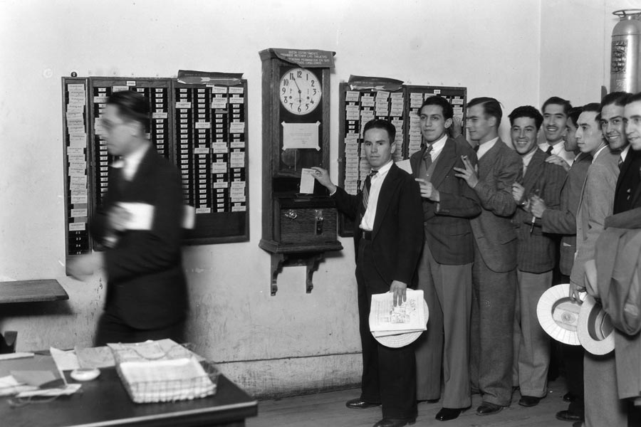
Keeping Track of Hours Worked
Employees not used to clocking in/out
May not record all hours worked
Problem areas
Before/after work
Lunch periods
Work at home

Slide 35
Communicate the Changes
Communicate with managers of reclassified employees and the employees themselves regarding the need to record all time worked
Prepare talking points and FAQs
Train the reclassified employees in timekeeping procedures

Slide 36
Legal Attempts to Stop Regulations From Being Implemented
A wider lens on workplace law

Slide 37
Congressional Review Act
Within 60 legislative days of publication of the Final Rule, a “Disapproval Resolution” must be passed by both chambers
Any Disapproval Resolution faces an uphill climb in the Senate, and would surely be vetoed by President Obama

Slide 38
A New President Will Be Elected in Nov. 2016
Incoming Republican administration could restart the regulatory process in January 2017
Difficult to “walk back” from salary level increases
More likely to limit or eliminate automatic salary increases

Slide 39
The Bottom Line
New rules are not going away
Determine exempt/non-exempt status of individuals
Decide how to pay reclassified exempt employees
Dec. 1st will be here soon. Don’t wait – start now!

Slide 40
Interns/ Volunteers
A wider lens on workplace law

Slide 41
Public Sector Internships
Public sector internships may be unpaid:
Service performed for civic or humanitarian reasons
Without promise, expectation, or receipt of compensation
Services offered freely and without pressure or coercion, direct or implied, from an employer
Individual is not otherwise employed by the public sector employer to perform the same type of service

Slide 42
Independent Contractor v. Employees
A wider lens on workplace law

Slide 43
Gig Economy v. DOL and Plaintiffs’ Attorneys
Two things happening at once:
Explosion of the on-demand or gig economy (Uberization of the workforce)
Epidemic of lawsuits claiming employees have been misclassified as independent contractors

Slide 45
6 Factors Considered
Is the work an integral part of employer’s business?
Do worker’s managerial skills affect his or her opportunity for profit and loss?
Relative investments of the worker and the employer.

Slide 46
6 Factors Considered
Worker’s skill and initiative required in performing the job.
Permanency of the worker’s relationship with the entity.
How much control does the employer have?

Slide 47
Thank you!
Gary Wheeler
Constangy, Brooks, Smith & Prophete, LLP
904-356-8900
gwheeler@constangy.com

