Slide 1
PRESENTEEISM
I Really don’t want to be here today
July 23, 2016
Brent Myron, M.Ed.
New Directions Behavioral Health

Slide 2
AGENDA
Introduction
Definitions
Causes
Costs
Steps to Reduce the Problem

Slide 3
Introduction
Presenteeism is defined as reduced productivity at work due to health problems or other events that distract one from full productivity

Slide 4
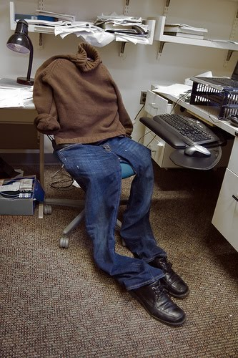

Slide 5
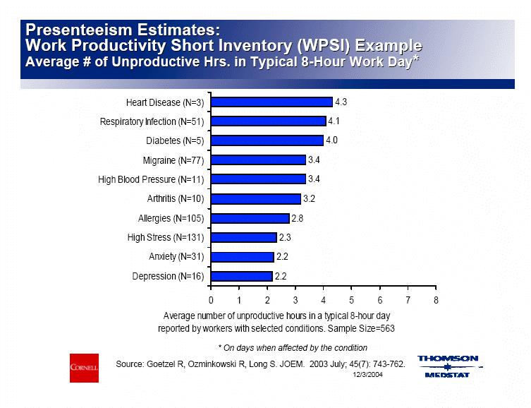

Slide 6
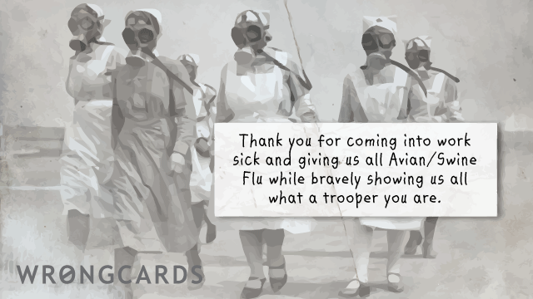

Slide 7


Slide 8


Slide 9
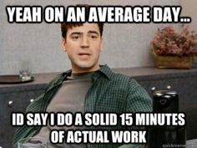

Slide 10


Slide 11
83% of employees report having gone to work despite illness

Slide 12
Presenteeism is difficult to measure
Absenteeism is apparent
A ‘silent draw’ on productivity
It is difficult to determine when, or how much, illness or a medical condition hinders performance when employees attend work

Slide 13
Mental Health issues have a stronger influence on presenteeism, unlike other health problems, because it is often not outwardly apparent

Slide 14
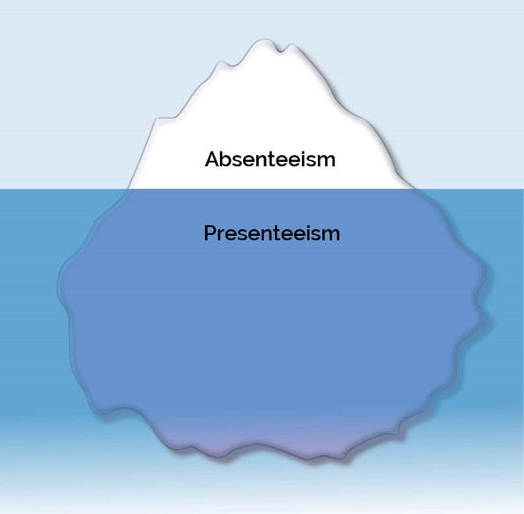

Slide 15
Anxiety
According to the National Institute of Occupational Safety and Health
  40% of American workers reported their job was very or extremely stressful
  25% view their jobs as the number one stressor in their lives

Slide 16


Slide 17
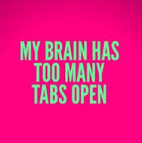

Slide 18
Depression
According to the Center for Disease Control
  9.1% of the population had symptoms of depression in the past two weeks
  4.1% had major depression
Depression is associated with between a 6-13% loss in worker productivity

Slide 19


Slide 20


Slide 21
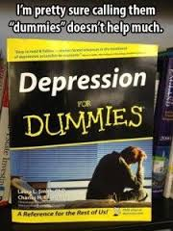

Slide 22
Causal Factors
Job insecurity
Job stress
Over-commitment to work
Financial problems
Individual boundarylessness
Time pressure

Slide 23
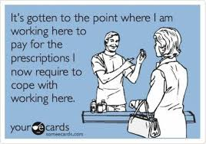

Slide 24
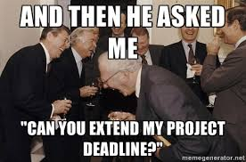

Slide 25
Costs of Presenteeism
$150 billion per year
Annual productivity losses for a typical firm or organization with 250 employees
  $160,000 to $245,000 per year
Studies have shown that employers have $3 of health-related productivity costs for every $1 of medical or pharmacy claims costs

Slide 26
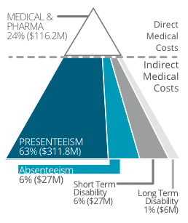

Slide 27
Most studies confirm that presenteeism is far more costly than illness-related absenteeism or disablility

Slide 28
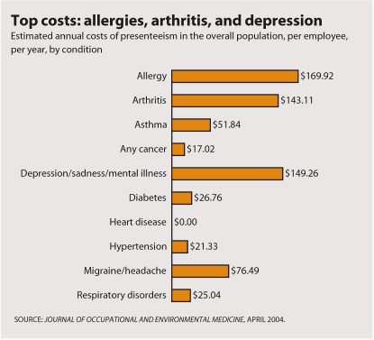

Slide 29
What to Do
Acknowledge that Presenteeism exists
Know the issues that are effecting your employees

Slide 30
Develop a policy on Presenteeism
Conduct an employee awareness program about depression, anxiety

Slide 31
Calculate the cost of mental health on the productivity (absenteeism and presenteeism) of your company
  www.workplacementalhealth.org
  www.depressioncalculator.com
  www.alcoholcostcalculator.org
  www.ibiweb.org

Slide 32
Educate managers about mental illness
Offer mental health screening

Slide 33


Slide 34
Discourage disciplinary action in an effort to reduce or control absenteeism
Provide paid sick leave and paid time off for workers

Slide 35
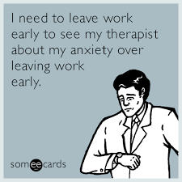

Slide 36
Make a business case for the company
  Add up direct costs
  Estimate indirect costs, such as absenteeism, presenteeism
  Write a report to management stressing the return on investment
  Stress the importance of investing in 'human capital'

Slide 37
Employee Assistance Programs
EAP's will provide the majority of your action items
Training
Short term rapid solution
Reporting
Studies show Return on Investment 3:1-12:1

Slide 38
Thank you!
Questions?

