Slide 1
Best in Class Employers and Organizational Profiles
Presented by:
Nicole Negvesky, GBDS,
Area Senior Vice President
83rd Annual FPHRA Conference
July 21, 2019 | 8:00 a.m. – 9:15 a.m.
Hyatt Regency, Coconut Point
Bonita Springs, Florida

Slide 2

Benefits Strategy & Benchmarking Survey
Conducted January to April 2018
Over 4,200 participating organizations
More than 300 questions covering the total rewards spectrum

Slide 3
Strategy &Benefit Attributes
Strategy
Benefit and Specific Attributes
Gallagher
NSBS

Slide 4
A best-in-class benchmarking analysis shifts the focus away from “average” so employers gain perspective on what it means to be the best.
Notes:
Employers look to their peers for significant patterns, best practices and philosophies as they strive to reach new heights in creating a better workplace. Finding the right formula for improved healthcare cost control and better employee attraction and retention isn't easy. That’s where best-in-class benchmarking comes in. It shifts the focus away from “average” so employers gain perspective on what it means to be the best by specifically looking at statistically significant attributes that distinguish the best in class and best of the best from their peers.

Slide 5
Purpose of Benchmarking
Gain perspective on what high-performing organizations have in common
Challenge assumptions about what’s possible, not cast a mold for the ideal
Get a sense of where they stand compared to the best in class of a similar size
Redefine and refine their strategies, tactics and operational execution to succeed
Notes:
From this employers can:
Gain perspective on what high-performing organizations have in common
Challenge assumptions about what’s possible
Get a sense of where they stand compared to the best in class of a similar size
Redefine and refine their strategies, tactics and operational execution to succeed

Slide 6
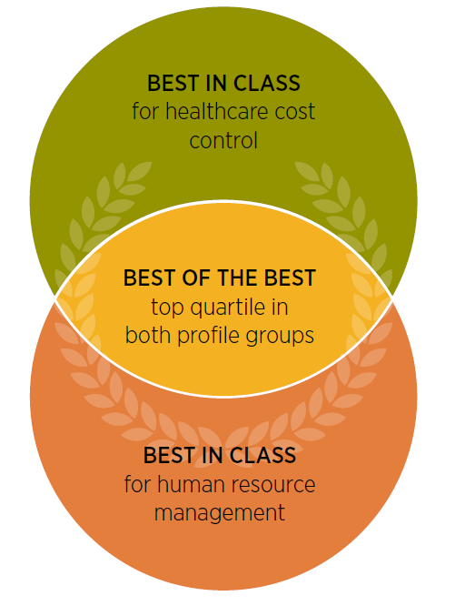
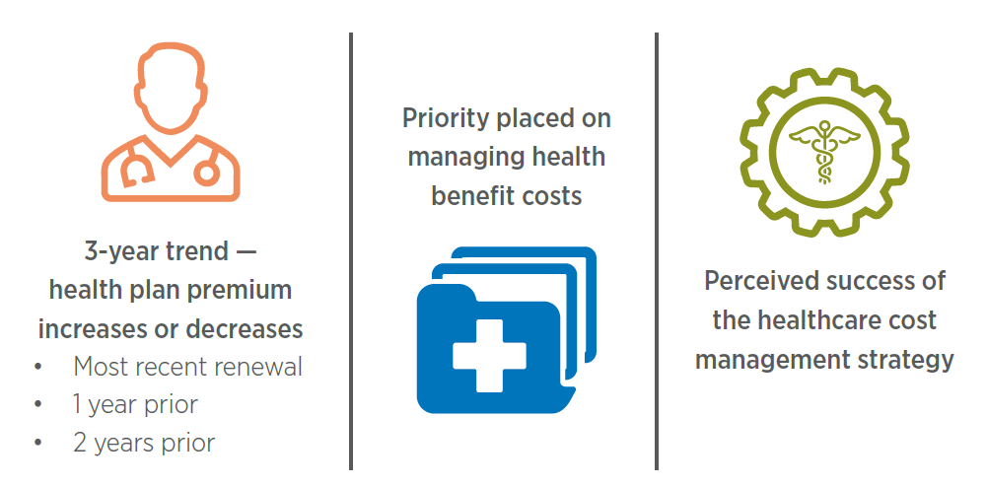

BEST IN CLASS Three Different Analysis…
Healthcare Cost Control
Human Resource
Management
Notes:
There are three different Reports in the BIC
The first Profile group is BIC employers in Healthcare cost control
The second Profile group is BIC employers in HR management
And the third Profile group , are employers we have identified the best-of-the-best who have achieved BIC status for both healthcare cost control and human resource management
Our national strategy in benchmarking survey allows us to Mine the data in many different ways including by Geography, industry, and size.
Because the Best in class represents the top quartile in health care cost in human resource management,It becomes much more difficult to Mine the data further to make The sampling statistically credible.
These Three different bass in class groups come in two different Groups. The best in class information is available by best in class large employers over 1000 employees, and best in class midsize employers.

Slide 7
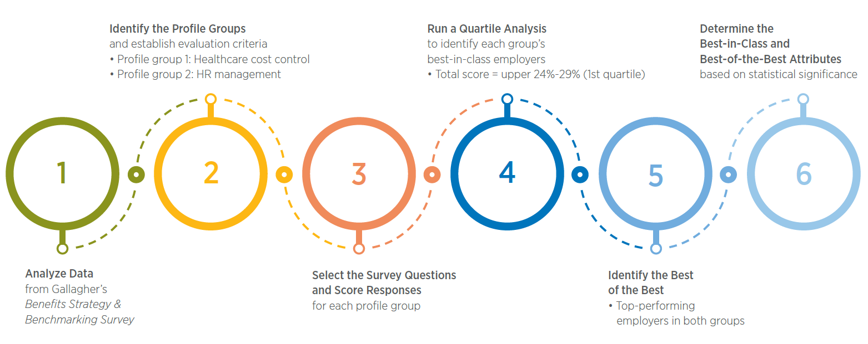
BEST IN CLASS Methodology
Notes:
We followed a 6 step process to identify and characterize best-in-class employers.
In step 1, we analyzed data from the 2018 Benefits Strategy & Benchmarking Survey
In step 2, we identified profile groups and established our evaluation criteria
• Profile group 1: Healthcare cost control
• Profile group 2: HR management
In step 3, we selected questions from the survey that were relevant to the two profile groups and scored all responses to those questions
In step 4, we divided the total scores for each profile group into quarters — or quartiles — according to their values, and assigned each employer to a quartile. The top quartile for each group includes the highest-scoring or “best-in-class” employers.
In step 5, we identified the best-of-the-best employers among the best-in-class pool. These exceptional performers scored in the top quartile of both profile groups.
And finally, we determined the attributes that separate the best-in-class and best-of-the-best employers from all other survey participants

Slide 8

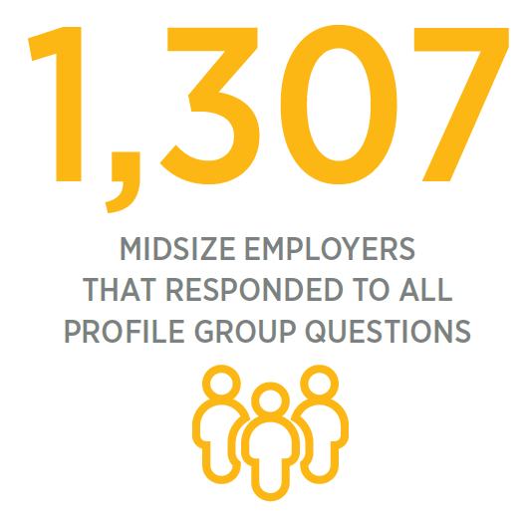
Methodology
Out of 1,307 employers…
387 qualified as best in class for healthcare cost control
313 qualified as best in class for human resource management
112 qualified as best of the best
Notes:
Out of 1,307 midsize employers that responded to the entire set of profile group questions, only…
387 qualified as best in class for healthcare cost control
313 qualified as best in class for human resource management
112 qualified as best of the best

Slide 9
How to apply this research
While we identify commonalities in the profile groups, it’s important to realize that the results are not a prescription for success.
Notes:
One thing we want to note is that this research is not prescriptive. There is no secret recipe for success. Instead, commonalities are described in approaches to strategies, programs and tactics that may be worth consideration. For example, some organizations may be effectively controlling costs but ignoring important employee needs. Others may be so focused on human resource management that they miss the chance to introduce effective cost control measures.
First and foremost, this research should be thought of as a chance to reflect on your organization’s approach and priorities. After assessment, you should look for key areas within best in class or best of the best approaches that align with your goals.

Slide 10
Best-in-Class Profile
Group — Healthcare
Cost Control
Midsize Employers

Slide 11
Measures of best-in-class performance
Notes:
Three criteria determined the midsize employer group that’s best in class at controlling healthcare costs. Employers were assigned points and placed in quartiles based on their relative performance in each measure. While quantitative data on health plan premium increases — or decreases — counted the most in scoring, qualitative data was also a factor.
Employers most likely to rank as best in class reported:
• Consistently low premium increases of 4.9% or less — across a three-year renewal period
• Higher prioritization of health benefits cost management
• Greater confidence in the effectiveness of their strategy for managing health benefit costs

Slide 12
Key Themes
Employing best-fit health plan design and management strategies
Reducing financial barriers to appropriate care
Investing in a holistic wellbeing strategy
Notes:
When survey responses from best-in-class employers were compared to the rest of their midsize peers, distinguishing attributes emerged. An analysis of these attributes identified three key themes:
• Employing best-fit health plan design and management strategies
• Reducing financial barriers to appropriate care
• Investing in a holistic wellbeing strategy

Slide 13


Employing best-fit health plan design and management strategies
Use A Multi-year Strategy For Benefits Planning
Notes:
Finding the right balance between better cost management and a more competitive benefits package demands close attention — for good reason. Employers that put an outstanding level of effort into managing their healthcare costs are more intentional in their benefits design and planning process, and have a stronger tendency to take a multi-year approach to benefits planning. With the advantage of this longitudinal perspective, they’re able to set long- and short-term goals with clear milestones for achieving their targeted outcomes. And this well-defined path helps inform well-reasoned decisions — guided by richer insight that allows employers to more fluidly change direction, when needed, to stay on track.

Slide 14
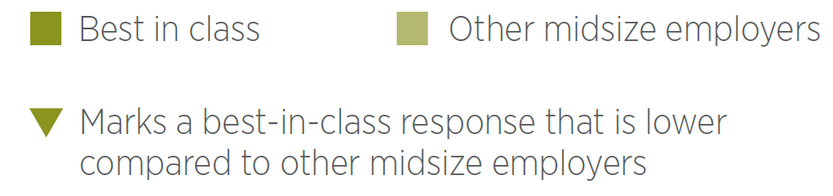

Employing best-fit health plan design and management strategies
Use Of Healthcare Approaches And Plan Design Elements To Reduce Spend
72% 64%
55% 40%
29% 20%
Offer 1-2 medical plans
Self-insure benefits funding
Use a specialty PBM
24% 18%
21% 13%
15% 11%
Apply a surcharge
or exclusion for spouses
with access to other coverage
Carve out pharmacy benefits
Use reference-based pricing
for healthcare services
Notes:
Best-in-class employers are more likely to offer either one or two medical plan options to employees. While this practice may limit employee choice, it does help rein in expenses and allows more focused plan management.
Other healthcare approaches and plan design elements showcase active and innovative healthcare benefits management. For one thing, the best in class more often self-insure their benefits. Although they assume the financial risk of providing employee health benefits — the trade-offs can make this decision worthwhile.
Rewards include greater administrative control, lower taxes, and the potential for direct cost reduction through better plan management and improved employee health and wellbeing.
Best-in-class employers are also reducing their pharmaceutical costs through a more calculated approach to pharmacy benefit management. Favored tactics include the use of a specialty pharmacy benefit manager (PBM) for 29%, compared to 20% of their peers, and a pharmacy benefits carve-out from the health plan (21% vs. 13%). The main advantage of working directly with a PBM is more efficient identification and implementation of underutilized tools for managing specialty pharmacy costs.
These employers are also more likely to apply a surcharge for coverage of spouses who have a benefit option available elsewhere. While tighter control of subsidies will not help improve employee satisfaction, this practice may prompt more careful consideration about adding spouses to the plan. And when employees do extend coverage to their spouse, organizations gain extra cash flow.
Reference-based pricing is another emerging plan element used by 15% of best-in-class employers. This cost-control mechanism caps the maximum amount employers will cover for certain healthcare services or procedures — often those that vary widely in price but don’t deliver superior outcome improvements, such as knee replacement surgeries. The employee or other covered patient pays the difference in cost above the reference price.

Slide 15
Reducing financial barriers to appropriate care
Increases To Employee Cost Sharing (In 2018)
47% 37%
40% 55%
40% 52%
None
Employee contributions to premiums
Overall plan design changes
(e.g., higher deductibles, copays
or coinsurance)
11% 19%
9% 16%
Deductibles
Out-of-pocket maximums
Notes:
Employers that are best at managing healthcare costs are not routinely shifting them to employees through increased premiums, deductibles, copays, coinsurance and out-of-pocket maximums. Instead, they’re deliberately designing their health plans to minimize hurdles to attracting and retaining talent. By limiting out-of-pocket expenses for a healthcare cost-sensitive workforce, the best in class are making coverage and care more affordable — increasing the likelihood that employees will seek the care they need and adhere to treatment plans. This strategy helps deter costly emergency health situations, boosting employees’ physical, emotional and financial wellbeing to support a more productive and engaged workforce.
Nearly half (47%) of best-in-class employers did not increase employee cost sharing in 2018, vs. 37% of their peers.

Slide 16

Reducing financial barriers to appropriate care
Provide Employees With Cost-transparency Tools
Notes:
And 57% offer direct savings through cost-transparency tools, which amounts to a 7-point advantage. These tools conveniently compare the costs of medical procedures, appointments and other care at different providers, as well as prescription drug cost estimates. As a result, employees gain more control through access to high-quality care at the lowest available cost.

Slide 17

Reducing financial barriers to appropriate care
Provide Nonsmokers A Discount On Premiums
(Smoker Surcharge)
Notes:
The best in class are also more apt to provide a discount on premiums for nonsmokers. This benefit can incent healthier behaviors and prevent unhealthy outcomes, potentially reducing healthcare costs for employees as well as employers.

Slide 18
Investing in a holistic wellbeing strategy
Employer Priorities For Health And Wellbeing
76% 65%
38% 33%
Agree that “Promoting and improving employee health and wellbeing
is a top priority for my organization.”
View healthcare cost reduction
as a top two reason for investing
in a wellbeing program
33% 27%
View improvements in the employee experience and employee satisfaction as a top two reason for investing
in a wellbeing program
Notes:
Best-in-class employers for healthcare cost control are intensely focused on employee wellbeing. More often than their peers, they recognize the link between promoting health and realizing healthier levels of employee engagement, job performance, job satisfaction — and ultimately retention. In fact, over three-quarters rate promoting and improving health and wellbeing as a top organizational priority, compared to just under two-thirds of their peers.
It naturally follows that these employers are also more likely to grasp the downstream ROI. For instance, they’re more inclined to identify improving the employee experience and workforce satisfaction as top reasons for wellbeing investment — in addition to reducing healthcare costs.

Slide 19
Investing in a holistic wellbeing strategy
Employer Priorities For Health And Wellbeing
45% 39%
31% 37%
Offer healthcare decision support
Lack a strategy for wellbeing
26% 19%
14% 9%
Have a comprehensive strategy focused on whole-employee health, including physical, emotional*, career and financial wellbeing
Offer an onsite health clinic
with medical services
* Includes community and social aspects
Notes:
These findings explain why the best in class are motivated to lead the way in focusing on the health of the whole employee. Beyond physical fitness, they show a stronger commitment to fostering emotional wellbeing, including the social and community aspects, as well as career and financial wellbeing.
The best in class also more frequently offer healthcare decision support to help employees ensure they’re getting the right care — at the right place, time and price. This includes live or telephonic assistance from benefit navigators or health coaches as well as online resources, such as provider-supplied quality comparators or disease and condition education tools. A small subset even provide an onsite health clinic with medical services. These clinics offer convenient, accessible and often discounted care — from providers that are intimately familiar with the organization’s health benefits, workplace culture and job functions.

Slide 20
Investing in a holistic wellbeing strategy
Emotional* And Career Wellbeing Program Elements
54% 45%
54% 48%
38% 28%
Company-sponsored gatherings
(picnics, holiday parties, etc.)
Performance reviews
Wellness committee or
wellness champions
36% 30%
33% 27%
25% 19%
Management or leadership
development training
Community engagement opportunities
Classes to promote
emotional wellbeing
(behavioral health, mindfulness, stress management, etc.)
* Includes community and social aspects

Slide 21
Investing in a holistic wellbeing strategy
Wellbeing Program Participation Incentives And Evaluation Metrics
Participation incentives
33% 26%
20% 13%
9% 14%
Cash or gifts
Premium differentials
Not offered
Notes:
Best-in-class employers more actively incentivize and measure the effectiveness of their wellbeing programs to ensure their investment is fruitful. To encourage program participation, they embrace the power of monetary incentives such as cash, gifts and premium differentials more readily than their peers.

Slide 22
Investing in a holistic wellbeing strategy
Wellbeing Program Participation Incentives And Evaluation Metrics
EVALUATION METRICS
39% 28%
27% 19%
23% 16%
Program participation
Employee engagement
Biometrics
21% 14%
18% 11%
15% 9%
Health risk assessments
Financial (claims data)
Healthcare utilization
14% 9%
8% 4%
10% 17%
Preventive care
Chronic condition management
Not used
Notes:
Participation, arguably the simplest measure of wellbeing program success, is far more commonly tracked by best-in-class employers. The same is true for employee engagement — often gauged with a satisfaction survey. Other measures used with exceptional frequency include biometrics, health risk assessments, claims, and healthcare use over time. These results may be the most objective indicators of performance.

Slide 23
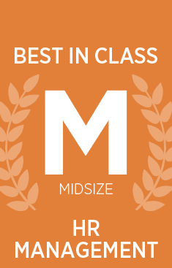
Best-in-Class Profile
Group — HR Management
Midsize Employers

Slide 24
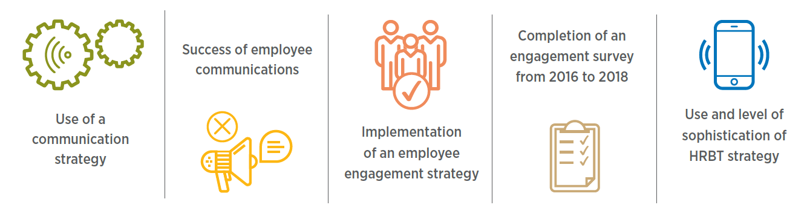
Measures of best-in-class performance
Notes:
Several criteria established the midsize employer group that’s best in class at HR management. Employers were assigned points and placed in quartiles based on their relative performance in each measure.
Two outcome-based measures were weighted nearly twice as heavily as the others:
• Turnover percentage
• Achievement of targeted turnover rate
Each of the remaining measures accounted for an equal number of points:
• Use of a communication strategy
• Success of employee communication efforts
• Implementation of a strategy to improve employee engagement
• Completion of a workforce engagement survey from 2016 to 2018
• Use of an HR and benefits technology (HRBT) strategy, and its level of sophistication

Slide 25
Key Themes
Aligning people management with organizational philosophy and operational priorities
Investing in employee growth and wellbeing to boost job performance and engagement
Recognizing the role of strategic healthcare management in engaging and retaining high-value employees
Notes:
When survey responses from best-in-class employers were compared to the rest of their midsize peers, distinguishing attributes emerged across three key themes:
• Aligning people management with organizational philosophy and operational priorities
• Investing in employee growth and wellbeing to boost job performance and engagement
• Recognizing the role of strategic healthcare management in engaging and retaining high-value employees

Slide 26
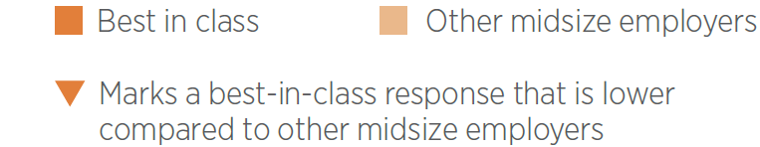
Aligning people management with organizational philosophy and operational priorities
Employer Perceptions Of Compensation And Benefits
Spending balance
Total compensation philosophy
86% 73%
32% 18%
Allocate the right amount of money
to wages and bonuses vs. benefits
Investment in workforce performance
to achieve business outcomes
19% 27%
Simply the cost of doing business
Notes:
An organization’s philosophy and culture are strong influencers of its approach to HR management. The best in class tend to view compensation and benefits as integral investments in optimizing workforce performance and achieving overall business outcomes. And they’re less likely to treat them simply as the cost of doing business.

Slide 27
Aligning people management with organizational philosophy and operational priorities
Approach To Compensation And Benefits Planning
Benefits planning
approach
Benefits planning
RESOURCES
COMPENSATION planning
RESOURCES
25% 13%
52% 43%
50% 40%
Have a multi-year strategy
for benefits planning
Organization’s
strategic plan
Organization’s
strategic plan
23% 14%
26% 20%
Multi-year labor
cost modeling
Multi-year labor
cost modeling
Notes:
Largely, it’s this outlook that drives them to put time and energy into creating a multi-year strategy for benefits planning at a higher rate than their peers.
In keeping with this broader mindset, best-in-class employers more often align both compensation and benefit plans with their organizational strategy and operational priorities. These efforts tend to include the use of multi-year labor cost modeling in compensation and benefits planning. By combining more comprehensive planning with a stronger appreciation of the direct value their employees bring to the business, the best in class are far more likely to successfully balance the amount of money they spend on compensation and benefits.

Slide 28
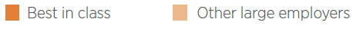
Aligning people management with organizational philosophy and operational priorities
Use Of Absence, Wellbeing And Communication Strategies
61% 46%
31% 18%
26% 7%
Absence management strategy for administering leaves and
disabilities (occupational and non-occupational)
Comprehensive wellbeing strategy holistically focused on
employee physical, emotional*, career and financial health
Comprehensive employee communication strategy
* Includes community and social aspects
Notes:
Comprehensive strategies that address important HR issues are another forte of best-in-class employers. Inevitably, employees need to be away from work. Policies and processes that smoothly transition them — as they leave and return to work — help reduce compliance-related risk and minimize operational interruptions. The best in class seem to recognize the value of these structures, because they’ve developed absence management strategies at a rate that’s 15 percentage points higher than their peers.
Proper and productive handling of leaves and disabilities is just one HR responsibility within the broader realm of cultivating employee wellbeing. The most inclusive wellbeing strategies recognize the importance of not only physical and emotional health, including community and social aspects, but also career and financial fitness. Because work and personal lives are intertwined, taking steps to support the whole employee — on or off the job — is also a strong move toward optimizing investments in the workforce.
Employees who experience less financial stress, feel supported in their professional growth, and have opportunities to give back to their communities tend to perform better and are often more satisfied. Much more frequently than their peers, employers that excel in HR management choose a holistic approach centered on these particular workforce objectives and outcomes.
Without an integrated communication strategy to activate success, core HR and other organizational strategies often fall short of their potential. Effective communications are the connection points for employees to better access, understanding and use of their benefits, programs and support tools. And they serve as a reliable mechanism for achieving a clear and consistent grasp of their organization’s goals, priorities and mission. Best-in-class employers are over three times as likely to have a comprehensive communication strategy compared to their peers.

Slide 29
Investing in employee growth and wellbeing to boost job performance and engagement
Support For Employee Growth And Purpose
Improvement of engagement
55% 29%
53% 30%
52% 27%
Define clear performance goals
Give timely and constructive feedback
Identify development needs
and create action plans
51% 25%
46% 23%
44% 24%
Communicate in a way that fosters trust and confidence
Support employees in developing and pursuing
a career path
Connect employees’ efforts to positive impacts on strategy, mission, vision or values
33% 15%
29% 14%
Provide interesting
and challenging work
Communicate clearly and transparently on how to earn bonuses or pay increases
Notes:
These employers also lead the way in implementing programs and practices that support career development and wellbeing. They’re ahead of their peers — by 25 percentage points or more — in defining clear performance goals, fostering trust and confidence through communications, and identifying and pairing development needs with action plans.

Slide 30
Investing in employee growth and wellbeing to boost job performance and engagement
Holistic Wellbeing Initiatives — Program Elements
Emotional wellbeing — social aspects
58% 49%
54% 46%
41% 34%
EAP provider programs
Company-sponsored gatherings
(picnics, holiday parties, etc.)
Paternity leave
38% 30%
37% 29%
32% 24%
Life event celebrations
(birthdays, weddings, graduations, etc.)
Wellness committee or
wellness champions
Flexible working arrangements
30% 18%
Classes to promote emotional wellbeing (behavioral health, mindfulness, stress management, etc.)
Notes:
The solid support of the best in class for the social aspects of emotional wellbeing is evident from their greater use of several initiatives. Among others, they include employee assistance programs (EAPs), company-sponsored employee gatherings, paternity leave and flexible working arrangements.

Slide 31
Investing in employee growth and wellbeing to boost job performance and engagement
Holistic Wellbeing Initiatives — Program Elements
Emotional wellbeing — community aspects
43% 32%
37% 26%
Volunteer opportunities
Community engagement opportunities
21% 12%
10% 4%
Charitable gifts matching or
donation programs
Clearly defined
CSR statement
Notes:
Employees of all generations — especially the younger set — also value opportunities to exercise their social conscience by connecting with the communities where they work. Some popular programs for giving back include volunteering and charitable matching. And, employers can validate their commitment to community wellbeing with a clearly defined corporate social responsibility (CSR) statement. This formal declaration serves as a guidepost for enacting support, too. All of these components are more often provided by employers that are best in class.

Slide 32
Investing in employee growth and wellbeing to boost job performance and engagement
Holistic Wellbeing Initiatives — Program Elements
Career Wellbeing
57% 48%
46% 30%
Performance reviews
Employee development training
42% 29%
25% 14%
Management or leadership
development training
Mentoring programs
13% 4%
Career counseling

Slide 33
Investing in employee growth and wellbeing to boost job performance and engagement
Holistic Wellbeing Initiatives — Program Elements
FINANCIAL Wellbeing
42% 29%
34% 27%
Financial advisor sessions
Employee discount programs
33% 21%
29% 21%
Financial literacy and other
education opportunities
Gym subsidies
16% 10%
Debt counseling
Notes:
Financial stress will often negatively affect physical and emotional health, productivity — and interactions with colleagues and customers. So it’s notable that the best in class are more likely to offer financial advisor sessions as well as financial literacy and other education opportunities, to help ensure employees’ finances are in order and their retirement planning is on target.

Slide 34
Investing in employee growth and wellbeing to boost job performance and engagement
Average Cost Of Employer-paid Benefits Per Eligible Employee
10% 21%
34% 25%
Less than $6,000
$15,000 or more
Notes:
The best in class are more inclined to focus on limiting turnover and achieving employee engagement, and these efforts correlate with their monetary investment in benefits. They tend to outspend their peers — allocating $15,000 or more to employer-paid benefits for each eligible employee. Conversely, they have a lower likelihood of spending less than $6,000. The ROI of these HR management tactics is expressed as increased employee attraction, satisfaction and retention.

Slide 35

Best of the Best —
Top Performers in Both Profile Groups
Midsize Employers
Notes:
To

Slide 36
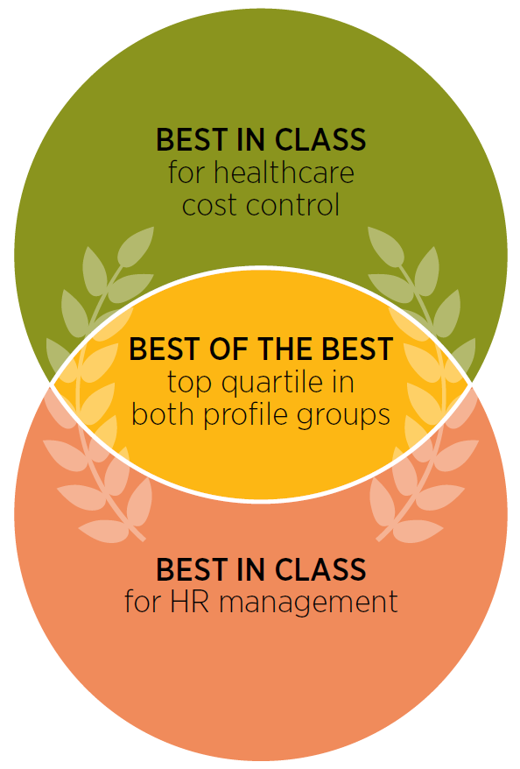
Top performers in both profile groups
Notes:
Top-performing, best-of-the-best employers achieved the highest combined scores and ranked in the top quartile for both healthcare cost control and HR management. At 9%, just 112 qualified among all midsize employers surveyed.

Slide 37
Key Themes
Diligently planning compensation and benefit strategies, and successfully allocating related resources
Supporting career growth to drive engagement and organizational success
Enriching employees’ health, work experience and productivity through comprehensive wellbeing investments
Implementing medical and pharmacy cost controls to enable employee affordability and long-term plan sustainability
Notes:
Not surprisingly, many of the differentiating characteristics of the best in class in each profile group also distinguish the best of the best. Four key themes emerged from an analysis of the best-of-the-best attributes:
• Diligently planning compensation and benefit strategies, and successfully allocating related resources
• Supporting career growth to drive engagement and organizational success
• Enriching employees’ health, work experience and productivity through comprehensive wellbeing investments
• Implementing medical and pharmacy cost controls to enable employee affordability and long-term plan sustainability

Slide 38
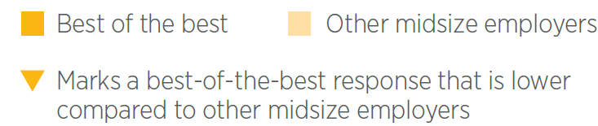
Diligently planning compensation and benefit strategies, and successfully allocating related resources
Top Operational Priorities
30% 18%
26% 16%
12% 20%
Increasing innovation
Managing or reducing risk
Maintaining profit margins
Notes:
Top operational priorities shape decisions made throughout an organization — and for best-of-the-best employers one of these more urgent needs is driving innovation. The creative energies of employees spur business growth, and a reputation for innovation can invigorate recruitment and retention results. So it makes sense that these employers are exceptionally dedicated to elevating the employee experience, through benefits, programs and policies that maximize their satisfaction and performance.
Risk mitigation is a proactive cost-control strategy that reduces disruption to operations and employee productivity — and it’s another critical operational priority more often associated with the best of the best. However, maintaining profit margins is less likely to make the grade. Perhaps profits are already healthy due to established measures that place these employers in the top echelon, or more likely, the organization expects that profits will follow a steady focus on their people and operational strategies.

Slide 39
Diligently planning compensation and benefit strategies, and successfully allocating related resources
Approach To Compensation And Benefits Planning
Planning approach
Planning resources
55% 41%
33% 14%
Organization’s strategic plan
for compensation
30% 15%
Multi-year strategy
for benefits planning
Multi-year labor cost modeling
for benefits
30% 21%
Multi-year labor cost modeling
for compensation
Notes:
Best-of-the-best employers are more than twice as likely to have a multi-year strategy for benefits planning. This long-term view helps keep them from getting bogged down in day-to-day challenges or a reactionary annual cycle of benefits renewal. Instead, it provides a framework for considering best-fit benefits design that’s both sustainable and aligned with organizational goals and culture.
When it comes to compensation planning, these employers tend to rely most on the organization’s strategic plan to inform decisions. They also use multi-year labor cost modeling as a resource for both compensation and benefits planning to a much greater extent than their peers.

Slide 40
Diligently planning compensation and benefit strategies, and successfully allocating related resources
Investment In Employee Compensation And Benefits
Employer perceptions
of total compensation
Proportion of
benefits spend
89% 75%
33% 46%
Allocate the right amount of money to wages and bonuses vs. benefits
Spend less than 20% of total
compensation on benefits
36% 20%
22% 13%
View as investments in workforce performance to achieve
business outcomes
Spend 40% or more of total
compensation on benefits
Notes:
Employers’ total outlay for compensation and benefits is a significant portion of operating expenses. The best of the best are more likely than their peers to view this expensive line item as an investment in maximizing workforce performance to achieve business outcomes. Most have struck a comfortable balance between money spent on compensation, including wages and bonuses, vs. benefits. They tend to assign a bigger portion of total compensation to benefits, and specifically, are more likely to spend 40% or more and less likely to spend under than 20%.

Slide 41
Supporting career growth to drive engagement and organizational success
Strategic Approach To Developing And Engaging Employees
Employee communication
26%
10%
Best in class
Other midsize employers
Notes:
They’re also more than twice as likely to have a comprehensive communication strategy, which tends to emphasize communications that connect employees with helpful resources.

Slide 42
Enriching employees‘ health, work experience and productivity through comprehensive wellbeing investments
Wellbeing Investment Philosophy
86% 66%
17% 10%
Agree that “Promoting and improving employee health
and wellbeing is a top priority
for my organization.”
Invest in wellbeing programs
to become or remain
an employer of choice
Notes:
Employers that excel at both controlling healthcare costs and managing HR share two core beliefs about holistic wellbeing — it’s a top organizational priority, and it helps boost employees’ health, work experience and productivity.
They understand how their investments link to improved attraction and retention, and consider becoming or remaining an employer of choice one of the top two reasons for this commitment.

Slide 43
Enriching employees‘ health, work experience and productivity through comprehensive wellbeing investments
Scope Of The Wellbeing Strategy
38% 19%
39% 44%
23% 36%
Focuses broadly on
whole-employee health, including physical, emotional*, career and financial aspects
Focuses exclusively on
traditional physical health options
(flu shot, tobacco cessation, biometrics screening, etc.)
No strategy
* Includes community and social aspects
Notes:
Best-of-the-best employers have a comprehensive strategy focused on whole-employee health and wellbeing at double the rate of their peers. And their holistic approach more often targets career and financial wellbeing as well as the physical and emotional aspects.

Slide 44
Enriching employees‘ health, work experience and productivity through comprehensive wellbeing investments
Total Wellbeing Program Elements
Physical wellbeing
65% 54%
50% 32%
50% 33%
Flu shots
Physical activity programs
Health risk assessments
46% 34%
45% 35%
42% 31%
Biometric screenings
Tobacco cessation
Weight management
Notes:
The biggest gaps in the availability of physical wellbeing benefits between these two segments occur with physical activity programs, health risk assessments, healthy vending or other eating choices, and disease management programs.
(continued on next slide)

Slide 45
Enriching employees‘ health, work experience and productivity through comprehensive wellbeing investments
Total Wellbeing Program Elements
Physical wellbeing
41% 25%
38% 24%
25% 16%
Healthy vending and/or eating
Disease management programs
Onsite fitness center
24% 11%
13% 4%
Onsite wellness coordinator or health professional
Onsite health clinic

Slide 46
Enriching employees‘ health, work experience and productivity through comprehensive wellbeing investments
Total Wellbeing Program Elements
Emotional wellbeing — social aspects
44% 29%
37% 25%
33% 20%
Wellness committee
or wellness champions
Flexible working arrangements
Classes to promote
emotional wellbeing
(behavioral health, mindfulness, stress management, etc.)

Slide 47
Enriching employees‘ health, work experience and productivity through comprehensive wellbeing investments
Total Wellbeing Program Elements
FINANCIAL wellbeing
42% 31%
37% 22%
37% 23%
Financial advisor sessions
Gym subsidies
Financial literacy and other education opportunities
Notes:
Financial wellbeing is also supported more extensively by the best of the best through gym subsidies and financial education opportunities. In each case, the difference is at least 14 percentage points.

Slide 48
Enriching employees‘ health, work experience and productivity through comprehensive wellbeing investments
Wellbeing Program Eligibility And Participation Incentives
Program eligibility
Participation incentives
38% 27%
25% 14%
Cash or gifts
Spouses
27% 18%
6% 2%
Employee recognition
Retirees
14% 8%
Employer contribution
to an HRA, HSA or FSA
Notes:
Best-of-the-best employers are more inclusive in setting eligibility rules for participation in wellbeing initiatives, just as they’re more likely to open up programs to spouses and retirees. For driving wellbeing program use and engagement, cash or gifts are the more prevalent incentives, along with employee recognition and employer contributions to health reimbursement arrangements (HRAs), health savings accounts (HSAs) or flexible spending accounts (FSAs).

Slide 49
Enriching employees‘ health, work experience and productivity through comprehensive wellbeing investments
Wellbeing Program Metrics
45% 30%
30% 21%
27% 15%
Program participation
Employee engagement
Health risk assessments
27% 17%
23% 12%
21% 10%
Biometrics
Financial (claims data)
Healthcare utilization
18% 10%
13% 4%
10% 3%
Preventive care
Chronic condition management
Lost work time
7% 16%
Not used
Notes:
Assessments not only measure wellbeing program effectiveness, but also may reveal areas for improvement or evolution. Participation is the most commonly captured metric, especially for leading employers compared to their peers. And surveys that solicit feedback on employee satisfaction provide a pulse check on receptivity and the perceived value of program options.
Clinically inclined analytics such as biometrics and health risk assessment data are also applied at a higher rate. Some of the least popular categories for gauging wellbeing program effectiveness include healthcare utilization, preventive care and chronic condition management. Notably, few best-of-the-best employers report that they don’t measure their wellbeing programs — at all — relative to their peers.

Slide 50

Implementing medical and pharmacy cost controls to enable employee affordability and long-term plan sustainability
Methods Of Reducing Healthcare Spend And Promoting
Employee Health
Health plan management
54% 44%
36% 26%
31% 22%
Self-insured benefits funding
Eligibility audits
Use of a specialty PBM
29% 18%
25% 15%
19% 11%
Integrated health and
disability management programs
Pharmacy benefit
carve-out
Reference-based pricing
for healthcare services
Notes:
The best of the best more readily control spend by taking an active, hands-on approach to behind-the-scenes plan management. More than half choose a self-funding arrangement that comes with the risk of insuring employee health, compared to 44% of their peers. However, they benefit from cost savings — gaining the chance to reap the fuller rewards of health and wellbeing initiatives.
These employers are also leaders in the use of two approaches for closely managing pharmacy benefits. One is enlisting the services of a PBM with expertise in handling this expensive class of medications, and the other is carving out pharmacy benefits from the health plan. A carve-out requires more involvement in management tasks for employers, but the effort provides an opportunity to rein in costs without a direct impact on employees.

Slide 51
Implementing medical and pharmacy cost controls to enable employee affordability and long-term plan sustainability
Methods Of Reducing Healthcare Spend And Promoting
Employee Health
Employee benefits
62% 51%
56% 43%
21% 10%
Cost-transparency
tools
Disease management
programs
Onsite health clinic
with medical services
Notes:
Spend can be further minimized by making supporting changes to health plan management and employee benefits. Nearly two-thirds of best-of-the-best employers provide cost-transparency tools to encourage employee use of high-value care — by choosing from various healthcare providers, medical procedures and pharmaceutical drugs based on comparative costs. Their increased use of disease management programs and onsite health clinics is further proof of a keen interest in better ways to reduce expenses, and improve health outcomes.

Slide 52
Implementing medical and pharmacy cost controls to enable employee affordability and long-term plan sustainability
Methods Of Reducing Healthcare Spend And Promoting
Employee Health
Employee incentives
25% 11%
17% 7%
Employer health plan contribution based on participation in a wellbeing initiative or program
Employer health plan contribution based on completion of a health risk assessment
Notes:
The best of the best also strongly promote health improvement through financial incentives. They’re more than twice as likely to base employer medical plan contribution amounts on participation in wellbeing programs or completion of a health risk assessment.

Slide 53
Implementing medical and pharmacy cost controls to enable employee affordability and long-term plan sustainability
Healthcare Cost-sharing Methods And Perceived Outcomes
METHODS
Perceived outcomes
41% 51%
75% 61%
Increase in the employee contribution
to the premium cost of employer benefits
Employee satisfaction
with employer benefits
39% 50%
73% 54%
Increase in employee cost sharing
through plan design changes
(e.g., higher deductibles, copays or coinsurance)
Affordable employee premium cost
for family coverage
32% 21%
73% 63%
Annual deductible amount of $0–$749 for an individual plan
Affordable employee costs for deductibles,
copays and/or coinsurance
Notes:
The focused attention on managing healthcare costs among the best of the best empowers them to maintain affordable health plans through lower cost share — and that makes for more satisfied employees. These employers are less receptive than their peers to cost increases in employee contributions to premiums, or higher cost shares for deductibles, copays and coinsurance. And, they’re more likely to report that the individual plan deductible is less than $750. This is noteworthy in an environment where high-deductible health plans are commonplace.

Slide 54
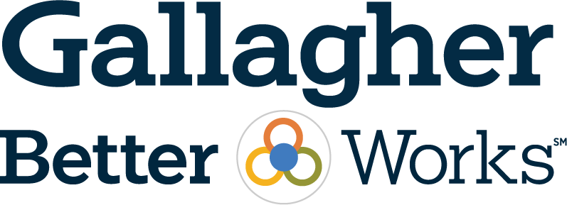
Thank You

Slide 55
The intent of this Survey is to provide you with general information regarding current practice within the employee benefits environment. The data does not constitute recommendations or other advice regarding employee benefit programs, and the user is in no way obligated to accept or implement any information for use within their organization(s). The decision to utilize any information provided rests solely with the user, and application of the data contained does not guarantee compliance with applicable laws or regulations regarding employee benefits. Information provided by the Survey, even if generally applicable, cannot possibly take into account all of the various factors that may affect a specific individual or situation. Additionally, practices described within the Survey should not be construed as, nor are they intended to provide, legal advice.
The Web Site and the Content do not constitute accounting, consulting, investment, insurance, legal, tax or any other type of professional advice, and should be used only in conjunction with the services of a Gallagher consultant and any other appropriate professional advisors who have full knowledge of the user’s situation.
Gallagher does not represent or warrant that the Content will be correct, accurate, timely or otherwise reliable. Gallagher may make changes to the Content at any time. Gallagher assumes no responsibility of any kind, oral or written, express or implied, including but not limited to fitness for a particular purpose, accuracy, omissions and completeness of information. Gallagher shall in no event whatsoever be liable to licensee or any other party for any indirect, special, consequential, incidental, or similar damages, including damages for lost data or economic loss, even if Gallagher has been notified of the possibility of such loss. For the purposes of this section the term “Gallagher” shall be construed so as to include Gallagher Surveys as a marketing division and/or Gallagher Benefit Services, Inc. and its affiliates.
© 2019 Gallagher Benefit Services, Inc.
All rights reserved. No part of this presentation, including the text, data, graphics, interior design and cover design may be reproduced or transmitted in any form, without explicit consent from Arthur J. Gallagher & Co.

