Slide 1
Mental Health Matters
Recognizing and Supporting the Mental Health Needs of Today

Slide 2
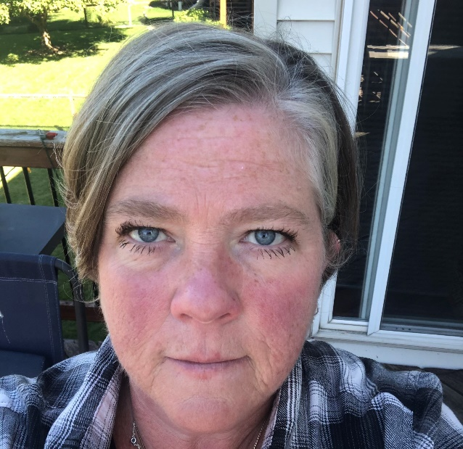
Tammy Huf, BSN, MBA, RN| United Health Group Director of Client Strategy, Optum Behavioral Health
Tammy is a Registered Nurse and joined United Health Group in 1999. She is currently responsible for client strategy, education, and innovations that improve the mental health of employee populations.
These strategies include understanding network changes, anti-stigma initiatives, clinical trends, and emerging innovations that help members access and engage in behavioral care. Her career has been patient-focused, promoting holistic clinical and behavioral wellness, and increased awareness of how all people can seek and find care.

Slide 3
The behavioral health challenge in the U.S.
1 in 5
60%
1 in 10
American adults is affected each year by mental health and substance use disorders¹
of adults with any mental illness didn’t receive mental health services in the previous year²
Americans with a substance use disorder receives treatment³
The novel coronavirus (COVID-19) and periods of social unrest contribute to emotional distress and occurrence of mental illness.
1. Center for Behavioral Health Statistics and Quality, Substance Abuse and Mental Health Services Administration. “Behavioral health trends in the United States: Results from the 2014 National Survey on Drug Use and Health,” 2015. Available at: https://www.samhsa.gov/data/sites/default/files/NSDUH-FRR1-2014/NSDUH-FRR1-2014.htm. 2. Park-Lee, E., Lipari, R. N., Hedden, S. L., Kroutil, L. A., & Porter, J. D. Receipt of services for substance use and mental health issues among adults: Results from the 2016 National Survey on Drug Use and Health. NSDUH Data Review. September 2017. Accessed on November 9, 2017 at https://www.samhsa.gov/data/sites/default/files/NSDUH-DR-FFR2-2016/NSDUH-DR-FFR2-2016.pdf. 3. Center for Behavioral Health Statistics and Quality. (2016). Results from the 2015 national survey on drug use and health: Detailed tables. Rockville, MD: Substance Abuse and Mental Health Services Administration.

Slide 4
Effects of challenges on our mental health
63% of respondents to a recent McKinsey survey reported feeling anxious or depressed in the past week, and 80% of respondents reported experiencing moderate to high distress related to COVID-19⁴.
45% of adults in the US reported that their mental health has been negatively impacted due to worry and stress over the virus.⁵
Crisis and suicide hotlines are fielding more and more calls and texts every day.
Isolation
Stress
Anxiety
Depression
Grief
https://www.mckinsey.com/industries/healthcare-systems-and-services/our-insights/returning-to-resilience-the-impact-of-covid-19-on-behavioral-health;
https://jamanetwork.com/journals/jamanetworkopen/fullarticle/2763229
Notes:
Sources
https://www.mckinsey.com/industries/healthcare-systems-and-services/our-insights/returning-to-resilience-the-impact-of-covid-19-on-behavioral-health
https://www.kff.org/health-reform/issue-brief/the-implications-of-covid-19-for-mental-health-and-substance-use/

Slide 5
Social isolation
Loneliness and lack of social connectedness have been directly linked to increased morbidity and mortality.
High blood pressure
Anxiety
Obesity
Depression
Substance use
47%
of people sheltering in place reported negative mental health effects due to coronavirus⁶
21%
27%
of those sheltering in place, reported a major negative impact on their mental health⁶
of those sheltering in place, reported a minor negative impact on their mental health⁶
Nirmita Panchal, Rabah Kamal, Kendal Orgera, Cynthia Cox, Rachel Garfield, Liz Hamel, Cailey Muñana, and Priya Chidambaram, The Implications of COVID-19 for Mental Health and Substance Use (Apr 21, 2020), https://www.kff.org/health-reform/issue-brief/the-implications-of-covid-19-for-mental-health-and-substance-use/
Notes:
Nirmita Panchal, Rabah Kamal, Kendal Orgera, Cynthia Cox, Rachel Garfield, Liz Hamel, Cailey Muñana, and Priya Chidambaram, The Implications of COVID-19 for Mental Health and Substance Use (Apr 21, 2020), https://www.kff.org/health-reform/issue-brief/the-implications-of-covid-19-for-mental-health-and-substance-use/

Slide 6
Stress
Stress is the body’s internal alarm that prepares it for action; the natural instinct to protect oneself
Avoid
30%
of people experience “secondhand stress” from the stress of others⁷
Complain
Obsess
Stress is contagious
but so is wellness
Self-doubt
7. Advisory Board, How to be a less-stressed leader; August 2018
Notes:
Source: Advisory Board, How to be a less-stressed leader; August 2018
7. Advisory Board, How to be a less-stressed leader; August 2018

Slide 7
Anxiety
Anxiety disorders occur when you feel worried or fearful about everyday events.
toilet paper
exercise
Social unrest
diet
alcohol use
school
COVID-19
friends
college visits
money
school
parents
frontline workers
spouse
kids
contamination
grocery shopping
job
projects
Emotional Symptoms |  | Physical Symptoms
Feelings of dread Feeling tense, jumpy, or moody Expecting the worst Watching for signs of danger |  | Racing heart, sweating, shaking hands, and shortness of breath Headaches, feeling tired, insomnia Upset stomach, diarrhea
Notes:
Source: https://www.nami.org/About-Mental-Illness/Mental-Health-Conditions/Anxiety-Disorders

Slide 8
Depression
Depression is one of the most common mental disorders in the U.S
PERSISTANT
17.3 million
adults in the US had at least one major depressive episode in the past year⁸.
Weight
ENERGY
death
Insomnia
Hopeless
decisions
INTEREST
empty
Pain
suicide
Appetite
concentration
digestion
8. National Institute of Mental Health (NIMH); Prevalence of Major Depressive Episode Among Adults; February 2019; https://www.nimh.nih.gov/health/statistics/major-depression.shtml
Notes:
8. National Institute of Mental Health (NIMH); Prevalence of Major Depressive Episode Among Adults; February 2019; https://www.nimh.nih.gov/health/statistics/major-depression.shtml

Slide 9
Grief and loss
We often associate grief with loss of life, but grief can come from the loss of anything
Grief…
can be experienced as feelings of shock, sadness, anger, and confusion.
can make people feel overwhelmed, lose interest in activities they used to enjoy, sleep less or more, or have changes in their appetite.
lives on a spectrum and it may look different for each of us.
is not on a schedule. It takes time and everyone’s timeline is different.
Notes:
https://www.liveandworkwell.com/content/en/member/article.16156.html
https://www.mhanational.org/bereavement-and-grief
https://newsinhealth.nih.gov/2017/10/coping-grief

Slide 10
Self Care Strategies
Here are some tips for helping take care of your own mental health
1
Focus on things you can control
Focus on things you can control
2
Take care of your body
Take care of your body
3
Make time to unwind
Make time to unwind
4
Connect with others
Connect with others
5
Set goals and priorities
Set goals and priorities
6
Take breaks from the news
Take breaks from the news
7
Be positive
8
Have compassion
9
Get help
Notes:
National Alliance on Mental Illness (NAMI) Minnesota
https://namimn.org/nami-minnesota-covid-19-resources/
https://2a392k31wksy2wkejf1y03dp-wpengine.netdna-ssl.com/wp-content/uploads/sites/188/2020/04/Focus-on-Your-Mental-Health.pdf

Slide 11
What can you do for others?
Employees can support each other by listening more effectively, showing compassion, and encouraging each other.
What not to do
What to do
Don’t judge or criticize.
Avoid the tough-love approach.
Don’t minimize the pain.
Avoid offering advice.
Avoid making comparisons.
Be there.
Be patient.
Try a small gesture.
Offer resources.
Notes:
National Alliance on Mental Illness: Tips For How to Help a Person with Mental Illness
https://www.nami.org/Get-Involved/NAMI-FaithNet/Tips-For-How-to-Help-a-Person-with-Mental-Illness
Optum EAP training: How to Recognize Changes in Employee Behavior and Take Appropriate Action
https://www.psychologytoday.com/us/blog/crazy-life/201810/how-talk-co-worker-about-their-mental-health

Slide 12
Resources
Below are various tools and resources to help you maintain or regain your emotional wellbeing.
Sanvello
Self-guided Cognitive Behavioral Therapy App for your mobile device
Websites
www.myUHC.com
www.liveandworkwell.com
Talkspace
Virtual Visit provider using messaging as the communication method. www.talkspacecom/connect
Psych Hub Videos
Member focused videos on various behavioral health and COVID-19-specific topics
Substance Use Disorder Helpline
1 (855) 780-5955
Anonymous and available 24/7
Public Crisis Line
1 (866) 342-6892, available 24/7
Free of charge and available to anyone

Slide 13
Thank You

