Slide 1



David Miklas
Law Office of David Miklas, P.A. www.MiklasEmploymentLaw.com
/FloridaEmploymentLaw
Sexual Harassment/ Discrimination
July 20, 2019

Slide 2

Illegal harassment can be based on:
Race
Age
Religion
National origin
Disability
Gender
Sexual orientation
Gender & Sexual orientation

Slide 3
Illegal harassment can be based on:
Race
Age
Religion
National origin
Disability
Gender
Sexual orientation
Gender & Sexual orientation
←All of these

Slide 4
Title VII prohibits covered employers from discriminating in employment on grounds of:
Race
Color
Religion
Sex, or
National origin.

Slide 5
Illegal harassment can be based on:
Race
Age
Religion
National origin
Disability
Gender
Sexual orientation
Gender & Sexual orientation
←All of these

Slide 6

Does Title VII protect job applicants, as well as employees?

Slide 7


Slide 8
Does Title VII protect actions other than terminations?

Slide 9
Title VII’s protections extend to hiring, firing, compensation, and all terms, conditions, and privileges of employment.

Slide 10
Does Title VII specifically prohibit “harassment” or a “hostile work environment?”

Slide 11

No.

Slide 12
Such discrimination is covered by the “terms, conditions and privileges” language of the statute. Harris v. Forklift Sys., 510 U.S. 17, 21 (1993).
Title VII is violated when the workplace is permeated with “discriminatory intimidation, ridicule, and insult” that is “sufficiently severe or pervasive to alter the conditions of the victim’s employment and create an abusive working environment.” Meritor Savs. Bank v. Vinson, 477 U.S. 57, 67 (1986).

Slide 13
What is Sexual Harassment?

Slide 14
What is Sexual Harassment?
A specific type of gender harassment.

Slide 15
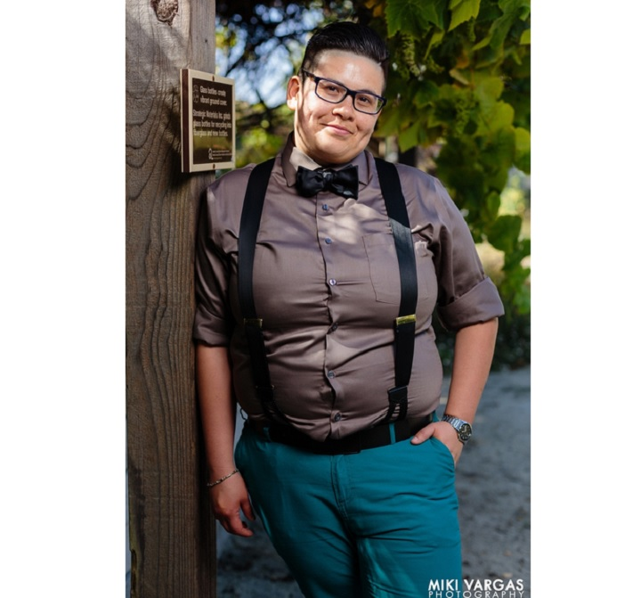

Slide 16


Slide 17
Title VII’s prohibition against gender discrimination includes discrimination based on sexual stereotypes, such as an expectation that women should dress or act in a certain way.
Price Waterhouse v. Hopkins, 490 U.S. 228, 235 (1989).

Slide 18
Is an employee’s transgender status protected under Title VII?

Slide 19
Courts have held that sex discrimination under Title VII includes discrimination against a transgender person for gender nonconformity.
Chavez v. Credit Nation Auto Sales, LLC, 641 F. App’x 883, 884 (11th Cir. 2016);
Ge v. Dun & Bradstreet, Inc., 2017 WL 347582, at *4 (M.D. Fla. Jan. 24, 2017).

Slide 20
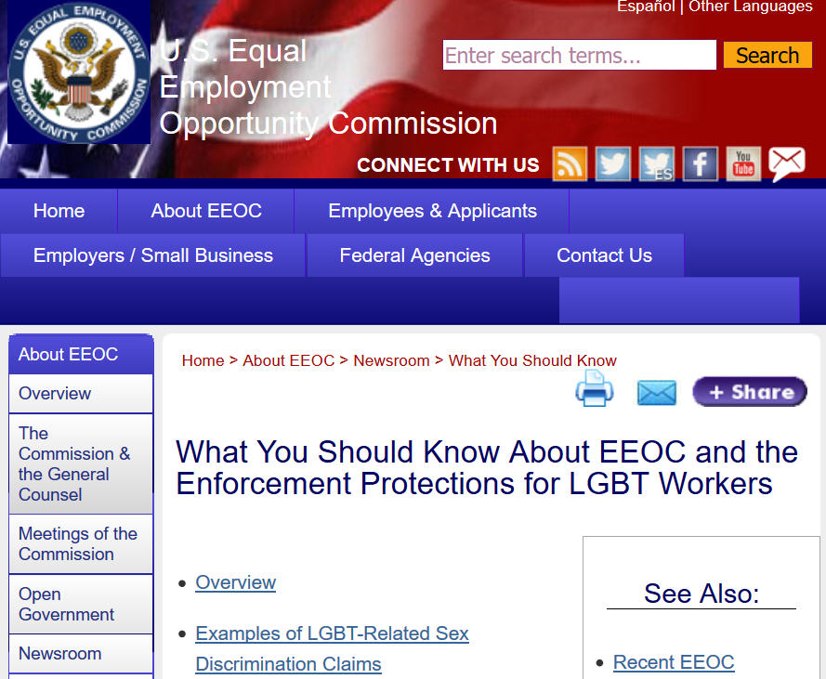

Slide 21
Some examples of LGBT-related claims that EEOC views as unlawful sex discrimination include:
Failing to hire an applicant because she is a transgender woman.
Firing an employee because he is planning or has made a gender transition.
Denying an employee equal access to a common restroom corresponding to the employee's gender identity.
Harassing an employee because of a gender transition, such as by intentionally and persistently failing to use the name and gender pronoun that correspond to the gender identity with which the employee identifies, and which the employee has communicated to management and employees.
Denying an employee a promotion because he is gay or straight.

Slide 22
Does Title VII include sexual orientation as a covered classification?

Slide 23
No.

Slide 24
EEOC guidance defines sex discrimination to include discrimination based on an employee’s sexual orientation and several courts have concluded the same.

Slide 25
Evans v. Georgia Hospital, 850 F.3d 1248, 1255 (11th Cir. 2017) - sexual orientation discrimination is not protected under Title VII.
Hively v. Ivy Tech Community College of Indiana, 853 F.3d 339 (7th Cir. 2017), a person who alleges that she experienced employment discrimination on the basis of her sexual orientation may state a case for sex discrimination for Title VII purposes.

Slide 26
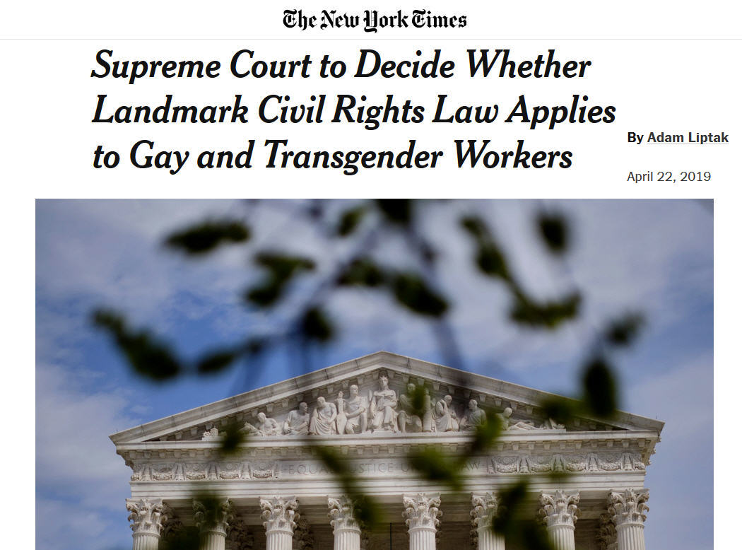

Slide 27
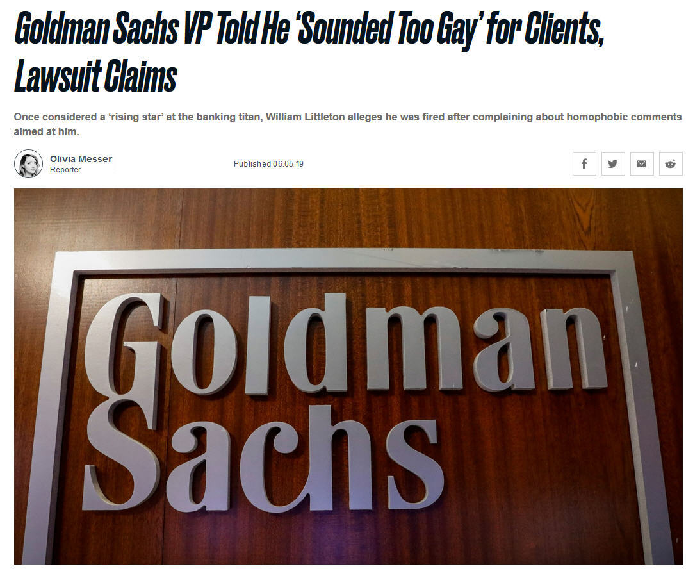

Slide 28
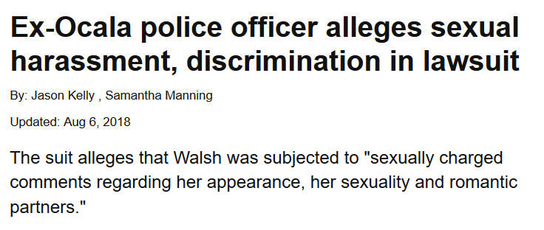

Slide 29
Claims for harassment used to be:
Hostile work environment vs. quid pro quo theory

Slide 30
All harassment claims are hostile work environment claims.
What changes is whether the alleged harasser was a supervisor

Slide 31
In order to prove a hostile environment claim, a plaintiff must show:
(1) that she belongs to protected group;
(2) that she has been subject to unwelcome harassment;
(3) that the harassment was based on a protected characteristic (sex);
(4) that the harassment was sufficiently severe or pervasive to alter terms and conditions of employment (an employee must prove that her work environment was both subjectively and objectively hostile); and

Slide 32
In determining whether the harassment was objectively hostile, courts consider four factors:
(1) the frequency of the conduct;
(2) the severity of the conduct;
(3) whether the conduct was physically threatening or humiliating, or a mere offensive utterance; and (4) whether the conduct unreasonably interfered with the employee’s job performance.

Slide 33
In order to prove a hostile environment claim, a plaintiff must show:
(5) that the employer is responsible for such environment under either a theory of vicarious or of direct liability.
As to #5, if the alleged harasser is a coworker, an employer is liable only if it was negligent—that is, if it knew or should have known of the harassing conduct but failed to take prompt remedial action.
“supervisor” for purposes of establishing vicarious liability

Slide 34
If, however, the alleged harasser is a supervisor, a different standard applies.
If the supervisor's harassment culminates in a tangible employment action, the employer is strictly liable.
But if no tangible employment action is taken, the employer may establish the affirmative defense set forth in Faragher/Ellerth:
(1) it exercised reasonable care to prevent and correct any harassing behavior; and
(2) the employee unreasonably failed to take advantage of the preventive or corrective opportunities that the employer provided.

Slide 35
If no tangible employment action and conduct is committed by a supervisor, an employer is liable unless the employer proves:
(a) that the employer exercised reasonable care to prevent and correct promptly any sexually harassing behavior, and
(b) that the plaintiff employee unreasonably failed to take advantage of any preventive or corrective opportunities provided by the employer or to avoid harm otherwise.
Faragher v. City of Boca Raton, 524 U.S. 775 (1998); Burlington Indus., Inc. v. Ellerth, 524 U.S. 742, 118 S. Ct. 2257 (1998)

Slide 36
a) reasonable care to prevent = anti-harassment policy that provides for a reporting mechanism that is distributed.
The complaint procedures must be reasonable and the harassment policy must be distributed.

Slide 37
b) Employee held to have unreasonably failed to take advantage of preventative or corrective opportunities because she waited more than two months before complaining about alleged harassment for Faragher/Ellerth purposes.
Harrison v. City of Tampa, No. 8:17-cv-01369-T-02CPT, 2019 U.S. Dist. LEXIS 93131, at *28-29 (M.D. Fla. June 4, 2019)

Slide 38
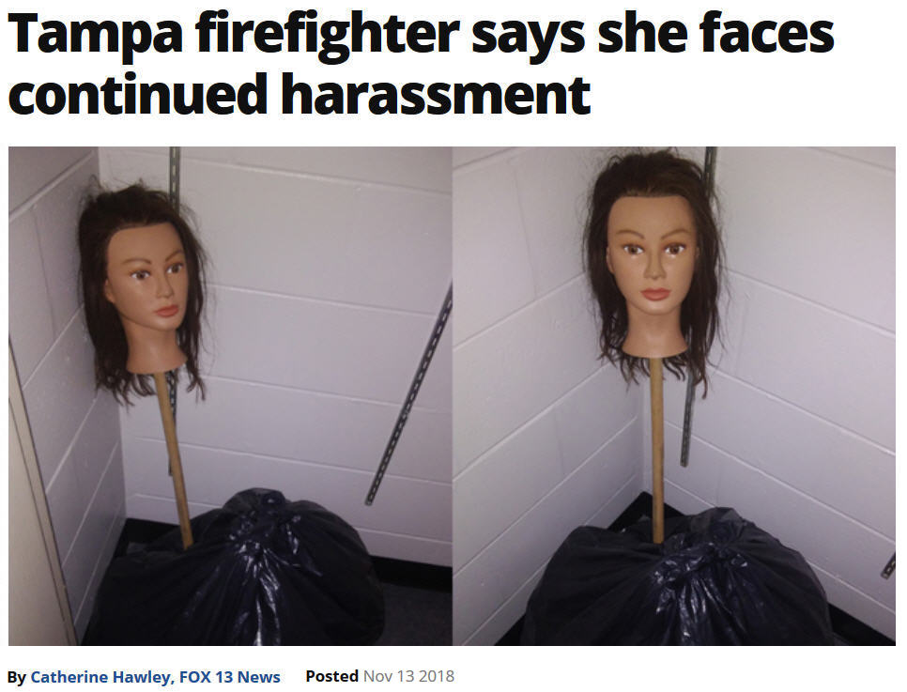

Slide 39
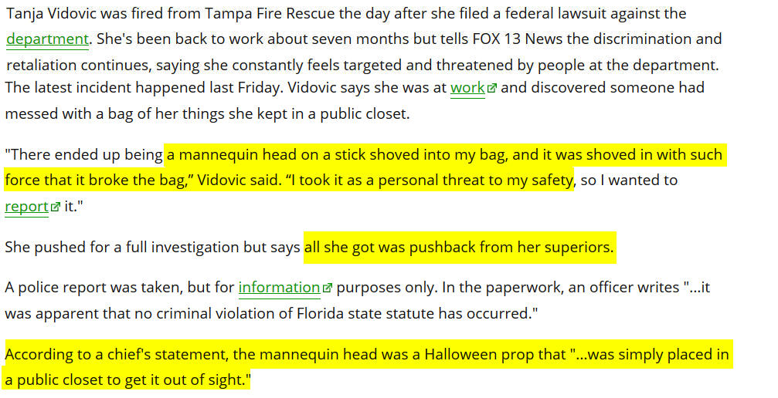

Slide 40
Where the employee has suffered a tangible employment action such as a
- suspension
- denial of a promotion,
- discharge,
- reassignment with significantly different responsibilities, or
- a decision causing a significant change in benefits the Faragher defense is not available (and the case proceeds under a quid pro quo theory, i.e. supervisor explicitly or implicitly conditioned a job, a job benefit, or the absence of a job detriment, upon an employee's acceptance of sexual conduct).

Slide 41
This affirmative defense only applies to supervisor liability, and an employer may not use it for co-worker harassment.

Slide 42
Employers are liable for sexual harassment directed against an employee by a non-supervisory co-employee where the employee shows that the employer both
(1) knew or should have known that harassment was occurring, and
(2) failed to take prompt and appropriate corrective action once it learned. A remedial measure is sufficient if it is reasonably likely to prevent the misconduct from recurring (warnings/counselings).
What about harassment by a Co-Employee or Non-Employee?

Slide 43
- Constructive knowledge because the harassment was pervasive enough;
- By showing that she complained to higher management.
- where the employer is aware of prior instances of harassment by the same harasser (relevant factors are the extent and seriousness of the earlier harassment and the similarity and temporal proximity to the later harassment).
How can an employee prove the employer knew or should have known of co-worker harassment?

Slide 44
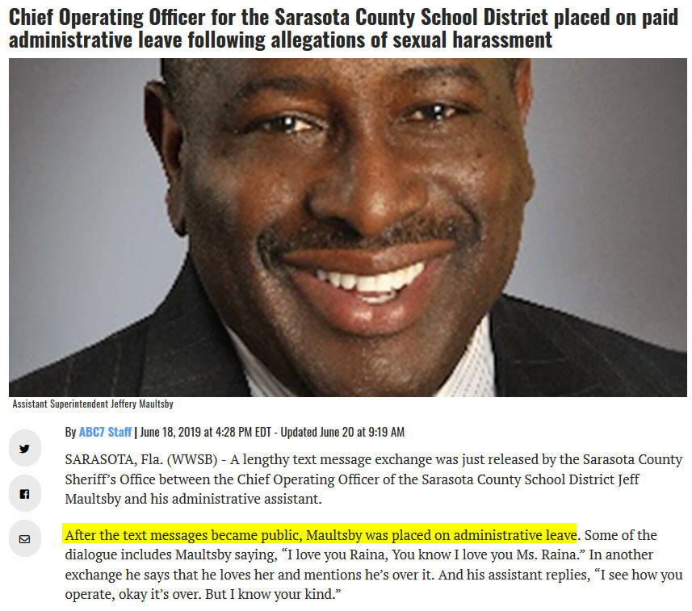

Slide 45
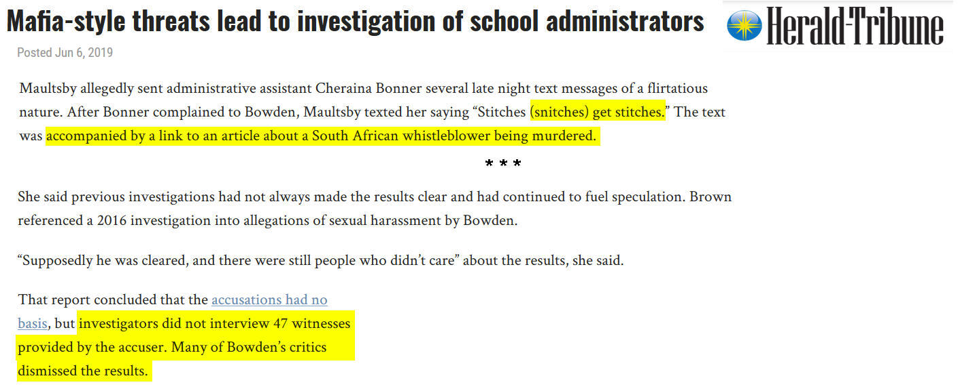

Slide 46

In the past year, what was the most frequently filed charge of discrimination?
Race
B) Disability
C) Sex (gender)
D) Retaliation
www.hrflorida.org

Slide 47

On 4/10/19 the EEOC released its FY 2018 data
Retaliation: 39,469 (51.6 percent of all charges filed)
Sex: 24,655 (32.3 percent)
Disability: 24,605 (32.2 percent)
Race: 24,600 (32.2 percent)
Age: 16,911 (22.1 percent)
National Origin: 7,106 (9.3 percent)
Color: 3,166 (4.1 percent)
Religion: 2,859 (3.7 percent)
Equal Pay Act: 1,066 (1.4 percent)
Genetic Information: 220 (.3 percent)
Although sex moved from 4th to 2nd, FY 2018 had fewer sex claims than FY 2017
7,609 sexual harassment charges - a 13.6 percent increase from FY 2017
www.hrflorida.org

Slide 48
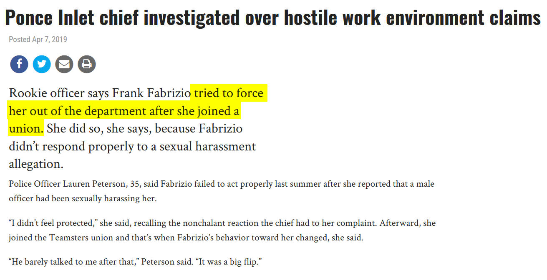
www.hrflorida.org

Slide 49
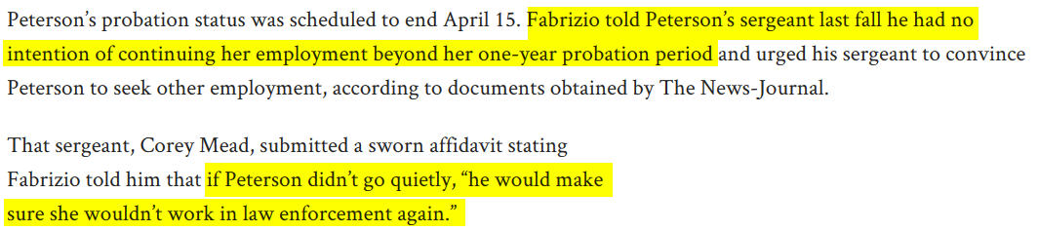
www.hrflorida.org

Slide 50
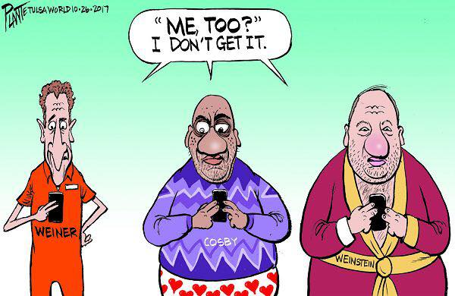

Slide 51
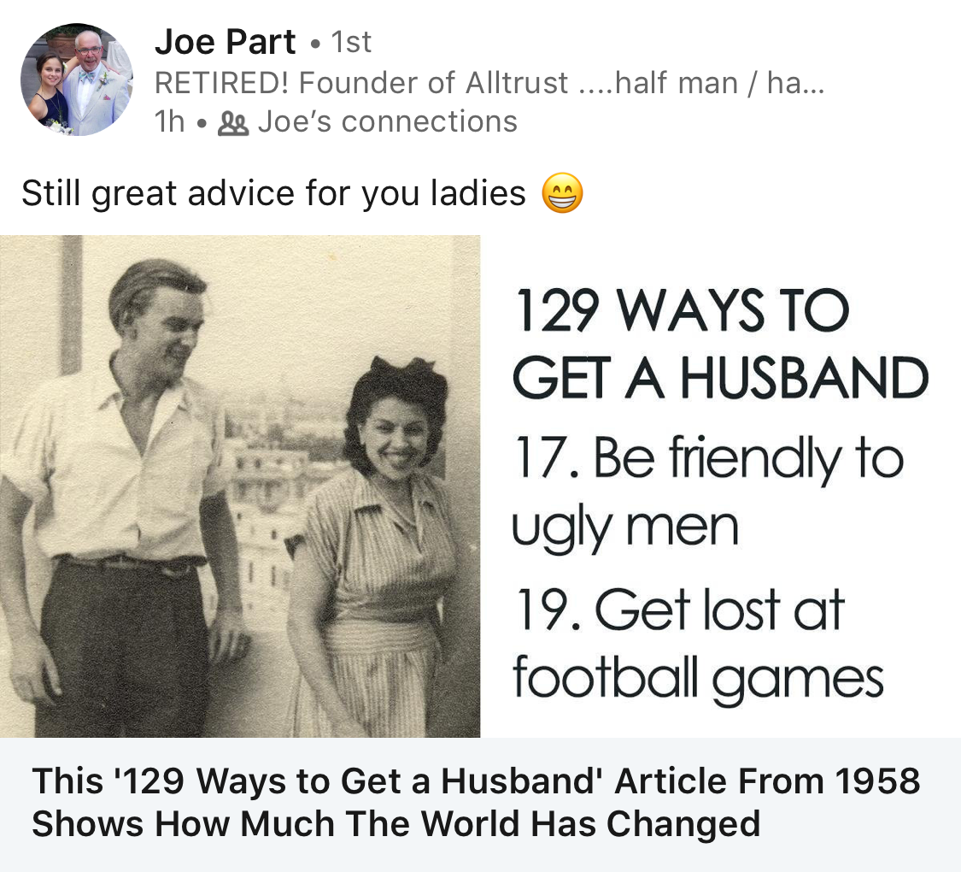

Slide 52
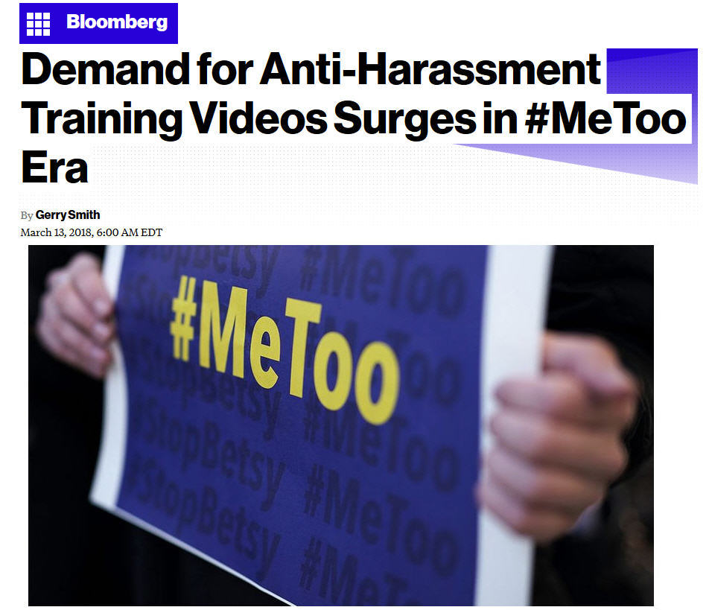
www.hrflorida.org

Slide 53
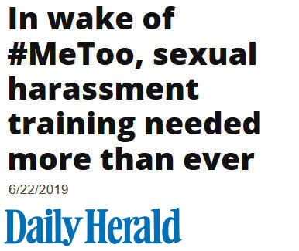

Slide 54
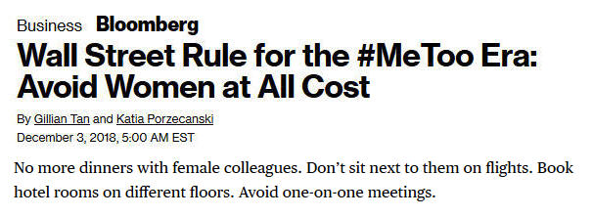

Slide 55
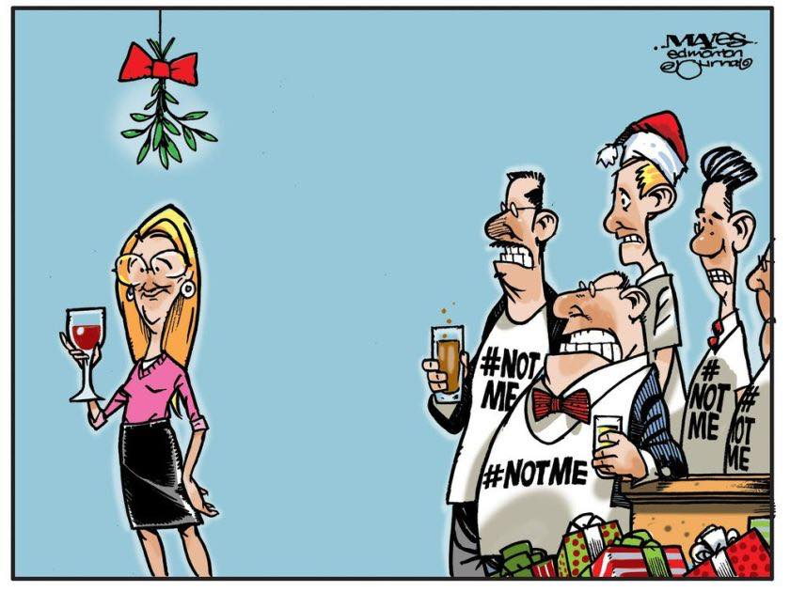

Slide 56
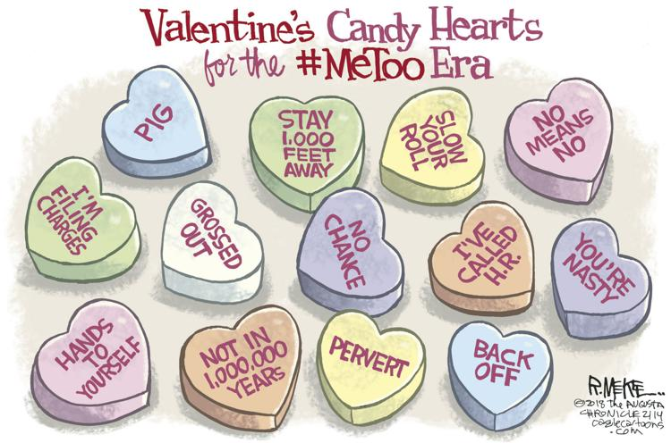

Slide 57
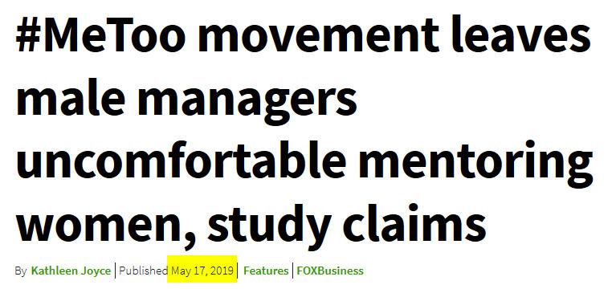

Slide 58
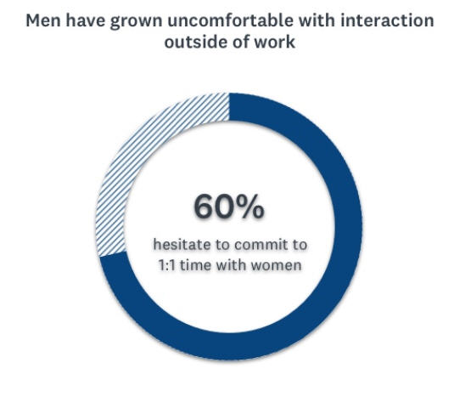

Slide 59
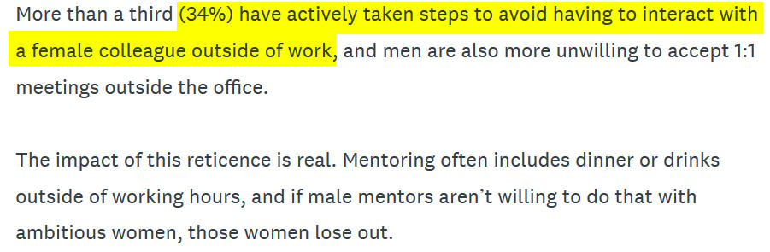

Slide 60
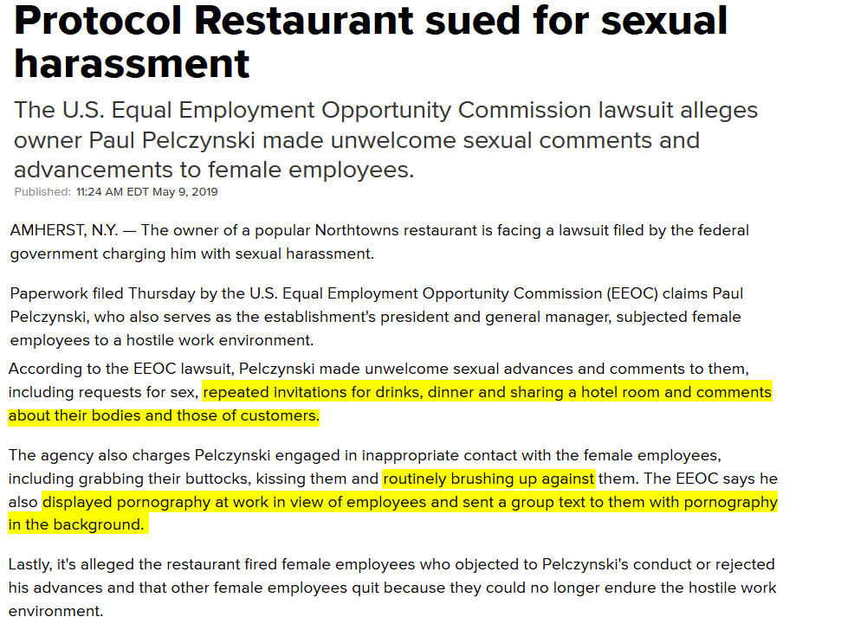

Slide 61


Slide 62


Slide 63


Slide 64
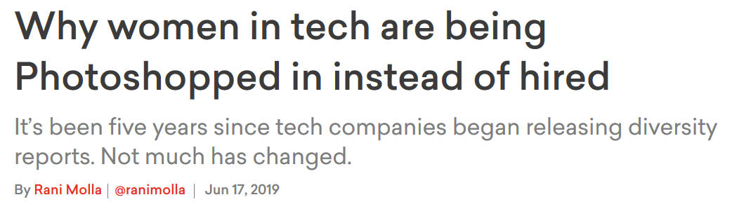

Slide 65

EEOC new training
www.hrflorida.org

Slide 66

www.hrflorida.org

Slide 67
These new harassment trainings incorporate the EEOC Task Force’s 2016 recommendations on compliance, workplace civility, and bystander intervention training.
www.hrflorida.org

Slide 68
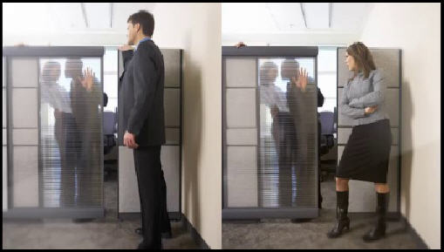

Slide 69

In April 2018 a spokesman for the EEOC’s Miami District Office announced that the EEOC will not only keep enforcing federal anti-harassment laws, it will also continue to encourage Florida employers to implement and maintain robust training in order to prevent harassment from occurring in the first place.

Slide 70

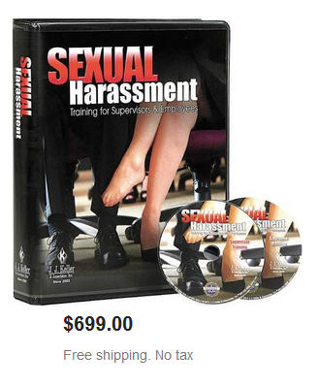
Choose live

Slide 71
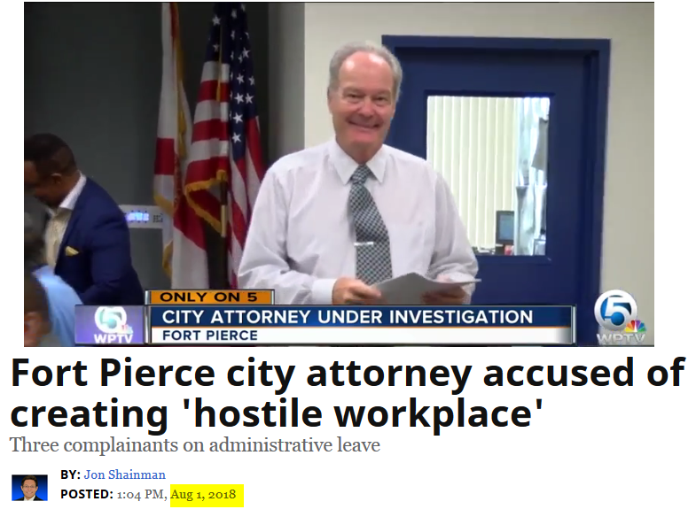
www.hrflorida.org

Slide 72
The investigation found:
He routinely talked about his past sexual experiences
Told administrative assistants to look on applicants' Facebook pages to see if they were “hot” or not.
Called a woman back from maternity leave a “milk maid.”

Slide 73
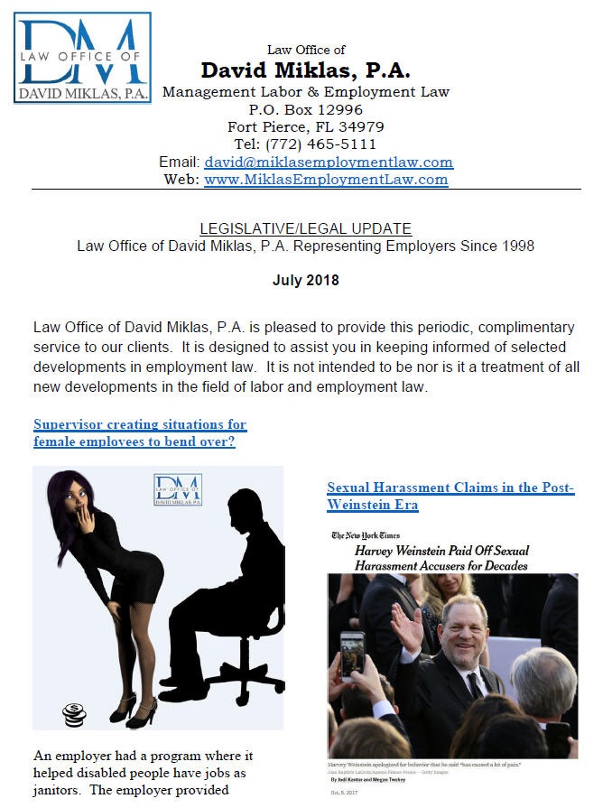

Slide 74

Which of these is sexual harassment?
Discussing sexual activities
Giving a shoulder massage
Asking a male co-worker about consensual oral sex with his girlfriend
Repeated requests for dates after being rejected
Wolf whistle

Slide 75
All could be examples of what may constitute sexual harassment

Slide 76
Examples of prohibited behavior include:
unwelcome sexual advances
requests for sexual favors
obscene gestures
displaying sexually graphic magazines, calendars or posters
sending sexually explicit e-mails, text messages
uninvited touching of a sexual nature
sexually related comments

Slide 77
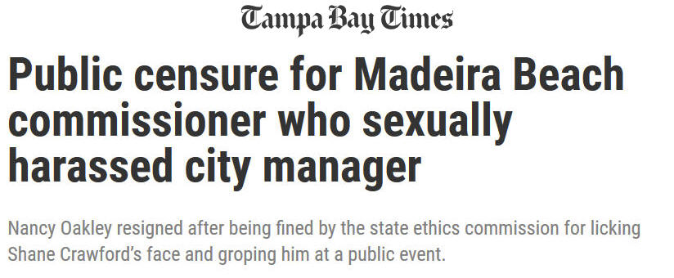

Slide 78
TRUE OR FALSE: Legally, sexual harassment requires that men sexually harass women.

Slide 79
FALSE: Women can sexually harass men, although women report most sexual harassment claims against men. What’s more, people of the same sex can engage in this kind of harassment. This can happen when, say, a married man’s colleagues repeatedly tell sexually explicit jokes that he finds offensive.

Slide 80
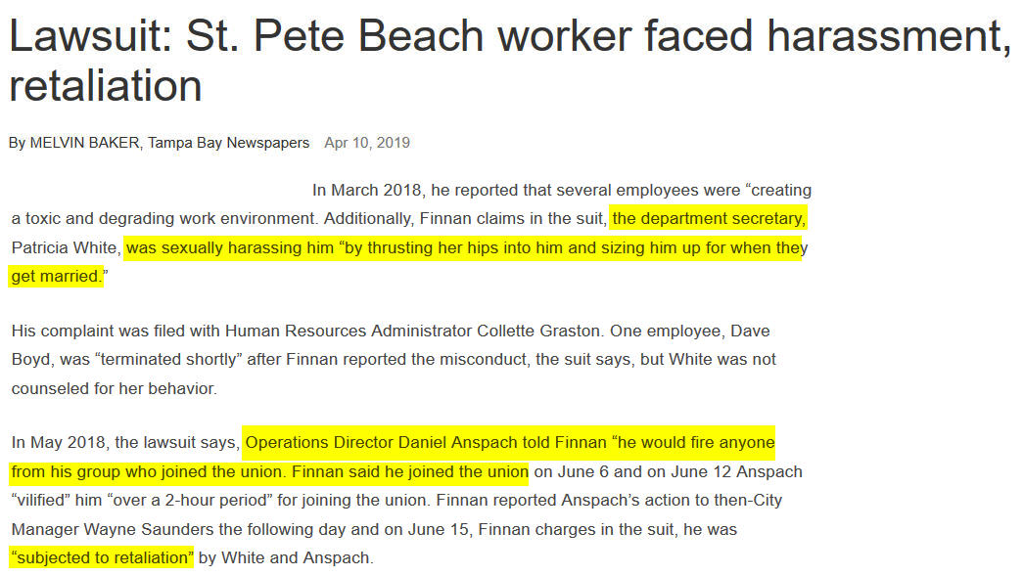

Slide 81
75% of women report that they have experienced some type of harassment.
Also, 75% of the people who experience harassment do not report it and do not go to their supervisor.

Slide 82
Conduct To Be Avoided
Employees should not engage in any of the following conduct:
Telling sexually explicit jokes;
Making requests for a date with someone who is not
interested;
Making suggestive, insulting or obscene comments;
Massaging someone;
Discussing sexual thoughts, fantasies or activities;
Unwelcome touching; or
Leering or making cat-calls or sexual gestures at someone.
Notes:
Employees should not engage in any conduct that could create a sexually hostile
work environment, such as —
Telling or e-mailing sexually explicit jokes;
Making repeated requests for a date with someone who is not interested, even if in jest;
Making suggestive, insulting or obscene comments, or using expressions such as "dear," "sweetheart," "doll" or "broad";
Massaging someone on any part of his or her body;
Discussing sexual thoughts, fantasies or activities;
Unwelcome touching; or
Leering or making catcalls or sexual gestures at someone.

Slide 83
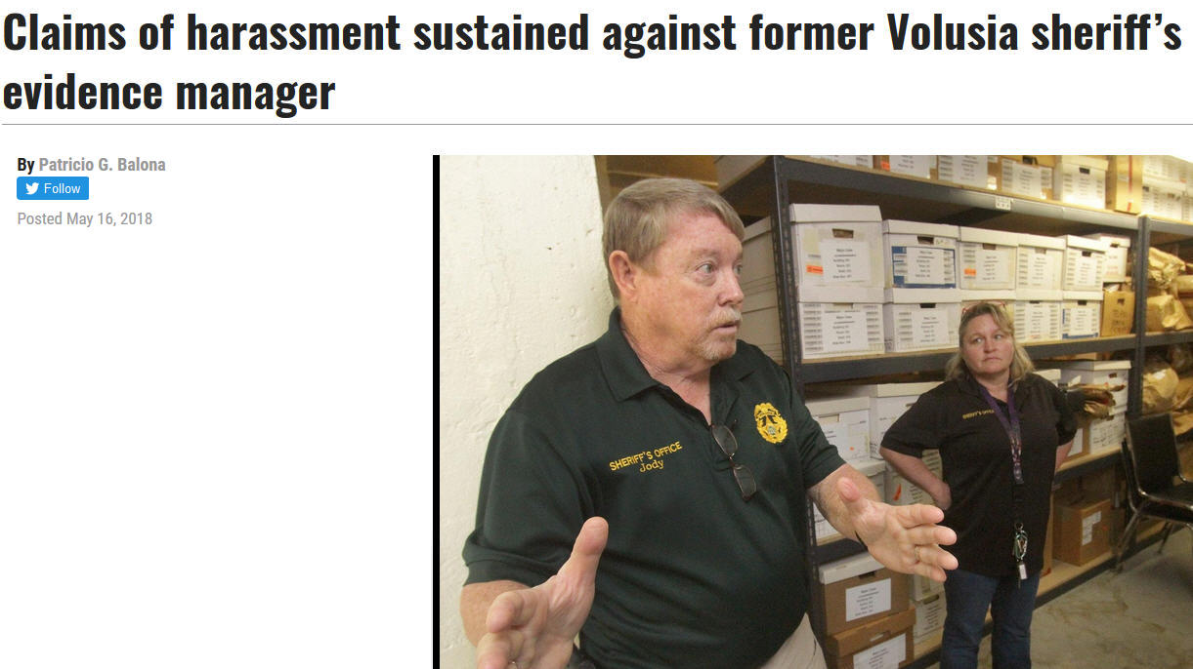

Slide 84
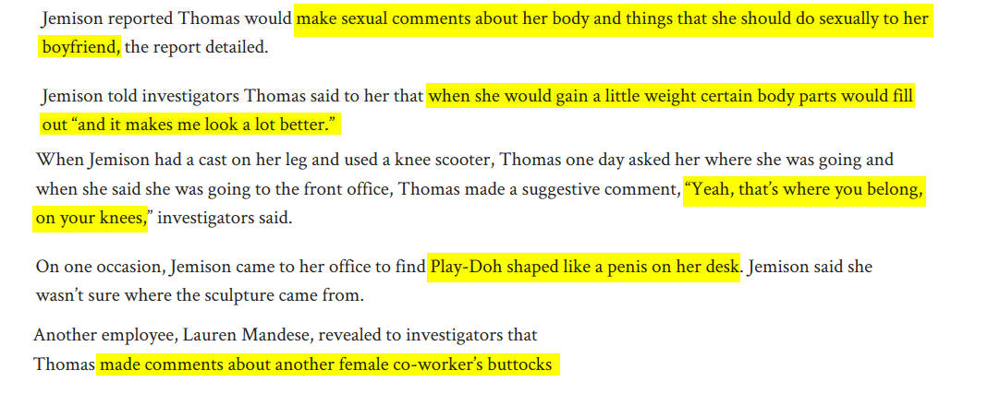

Slide 85
Conduct To Be Avoided (cont’d)
Employees also should not engage in any of the following conduct:
Displaying sexually explicit magazines or cartoons;
Making inappropriate comments about appearance or dress;
Apologizing to the "ladies in the room";
Assuming that a woman is subordinate to a man;
Addressing a woman less formally than her male
counterparts;
Using stereotyped language or conversation topics; or
Insisting on ordering food or carrying a briefcase for a woman.
Notes:
The following conduct may also create a sexually hostile work environment and
should be avoided by all employees:
Displaying sexually explicit magazines or cartoons, or calendars showing individuals in bathing suits or underwear;
Making inappropriate comments about appearance or dress;
Apologizing to the "ladies in the room" for cursing, or announcing an end to sexist jokes when a member of the opposite sex approaches;
Assuming a woman is subordinate to a man, or addressing a woman less formally than her male counterparts;
Using stereotyped language ("she's emotional," "she's indecisive," "she's sensitive") or conversation topics (clothes, cooking, kids) when interacting with female employees; or
Insisting, despite a woman's objections, on ordering food or carrying a briefcase for her.

Slide 86
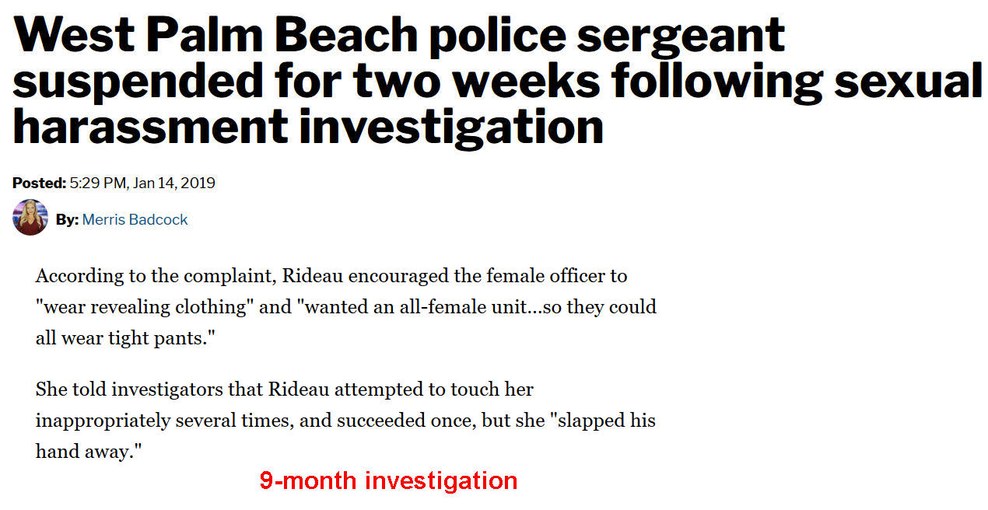
Comments about clothes

Slide 87
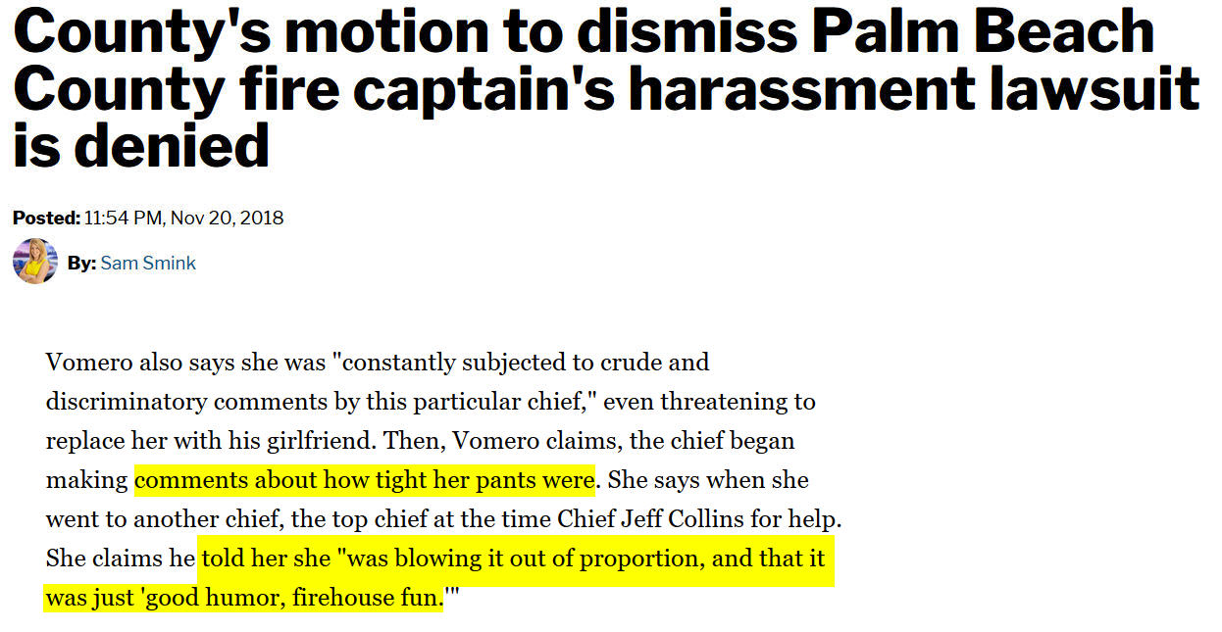
Comments about clothes

Slide 88
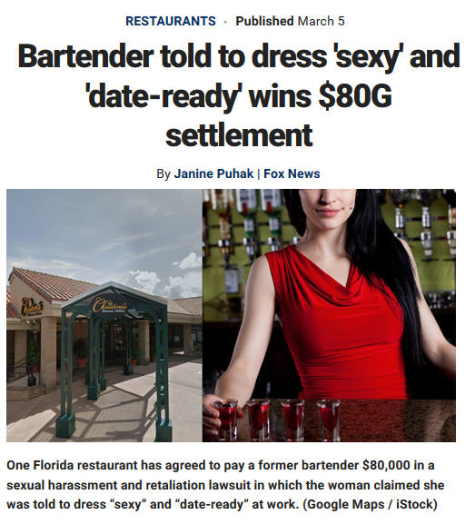

Slide 89
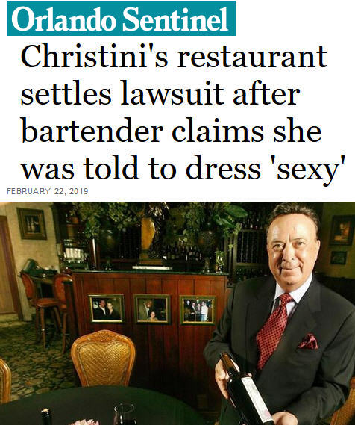

Slide 90
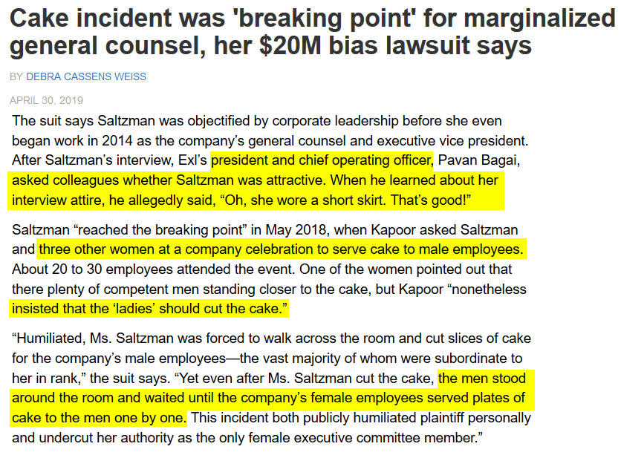

Slide 91


Slide 92

Questions? Newsletter?
David Miklas
Law Office of David Miklas, P.A.
Representing Florida Employers Since 1998
www.MiklasEmploymentLaw.com
/FloridaEmploymentLaw
Email: david@miklasemploymentlaw.com

