Slide 1
2016 Changes to Chapter 55A-7, FAC
Update June 3, 2016

Slide 2
What is “Veterans’ Preference” (VP) ?
VP means laws enacted to prevent veterans from being penalized in their civilian careers for their time in military service. VP laws recognize the economic loss suffered by citizens who have served their country in uniform, restore veterans to a favorable competitive position for public employment and acknowledge the larger obligation to disabled veterans. VP shall be awarded for numerically based and non numerically based selection.

Slide 3
What are Minimum Qualifications (MQs) ?
MQs means specification of kinds of experience, training, education, and licensure or certification (if applicable) that provides appropriate job-related evidence that an applicant possesses the minimum required knowledge, skills and abilities necessary to the discharge of the duties involved.

Slide 4
What is a “vacant position”?
A position which the employer has announced as being open for recruitment and available to “ALL” applicants. A position that is announced as being open to current employees only, to be filled by the reassignment, promotion or demotion of an employee is not a vacant position for the purpose of this chapter.

Slide 5
What is a “veteran” or “war time veteran”?
Active duty for training will not qualify a veteran for veterans’ preference eligibility.
A veteran must have served at least 1 day in a campaign or expedition for which a badge or medal was authorized or the global war on terrorism medal or during one of the specific periods of war time service.

Slide 6
What is the employer required to tell VP applicants when they are applying for a position?
The employer shall give notice in all written announcements and audio and video advertisements of employment opportunities subject to preference.
The employer shall inform VP eligible applicants at the time of application of their rights and the process for requesting an investigation.
Any employment application shall ask if the applicant is requesting VP and shall state the documents that are required to accompany the application.

Slide 7
What happens if the proper documentation is not received?
If a Veterans’ preference eligible expresses their intent to use VP on the application and fails to provide the correct or all documentation; the entity must reach out to the applicant and inform them what must be supplied and give them adequate time to do so.
The veteran is entitled to special consideration at every step of the process and this is a step.

Slide 8
If the VP applicant is NOT selected….what MUST the employer do?
If a VP eligible applicant is not selected for a position, the employer shall notify the applicant within 14 business days of the hiring decision. The timeclock begins to run when the employer secures a commitment from the selected applicant for a date certain to start work….and…

Slide 9
The employer must also…..
The employer is required to document and justify the decision to hire a non-preference-eligible applicant over the preference-eligible applicant because the decision may be challenged and result in an investigation and review by the Department of Veterans’ Affairs.

Slide 10
How do you show preference when using a numeric scoring system for your selection?
The VP eligible person shall have their qualifying score augmented when a numeric selection process is in place. Their name shall be placed on the appropriate register in the order of the score plus the applicable augmentation.
Depending upon how they qualified for VP, examination scores of 100 will be augmented by 15,10 or 5 points to their qualifying score.
Where the examination score is more or less than a 100, it is permissible to apply an alternative method and use percentages, 15%, 10% or 5% once again depending upon how they qualified for VP.

Slide 11
What is “Absolute Preference” ?
If a veteran has a disability rating of 30% or greater and
If the position is NOT classified as professional or technical…
The veteran shall be placed at the top of the appropriate register or employment list and will be given absolute preference.

Slide 12
How do you show preference in a non-numerical selection process?
When a non-numeric selection process is used, VP in appointment,re-employment and retention requires that the preference eligible applicant be given preference at every step.
Preference eligible applicants who meet the MQs for the open positon shall be considered for selection and shall be granted an interview in All cases.

Slide 13
If the VP applicant is NOT selected in a non-numeric process….what MUST the employer do?
When a determination is made that the preference eligible applicant is NOT going to be selected, a higher level of management, having authority to overturn the initial selection, shall review such determination.
This procedure must be documented because the decision may be challenged and result in an investigation and review by the Department of Veterans’ Affairs.

Slide 14
What happens if the choice comes down to vet vs. vet?
When two equally qualified preference eligible applicants are considered for an open position, selection preference shall be award based upon the eligibility category with first preference to a compensable disabled veteran and tiered down from there.

Slide 15
What happens if there is intentional misrepresentation?
Intentional misrepresentation of ANY claim for preference shall disqualify the applicant from claiming VP on future applications, and if employed, shall be subject to disciplinary action by the employer, including dismissal.

Slide 16
New Forms
All applicants must supply a VP Certification, FDVA form VP-1
Current members of a Reserve Component or the Florida National Guard shall supply, FDVA form VP-2 that certifies they are currently active members
The unremarried widow or widower of a deceased veteran shall supply, FDVA form VP-3 that certifies that they have not remarried.
These forms are available at the FDVA website.

Slide 17
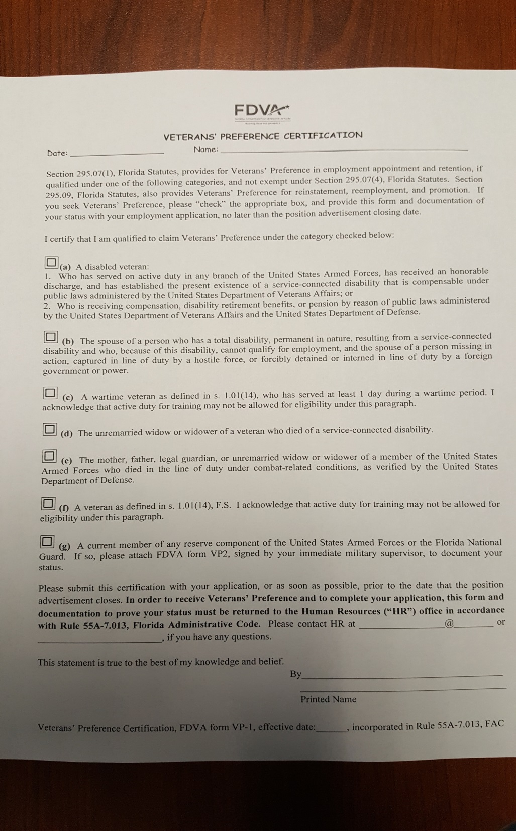

Slide 18
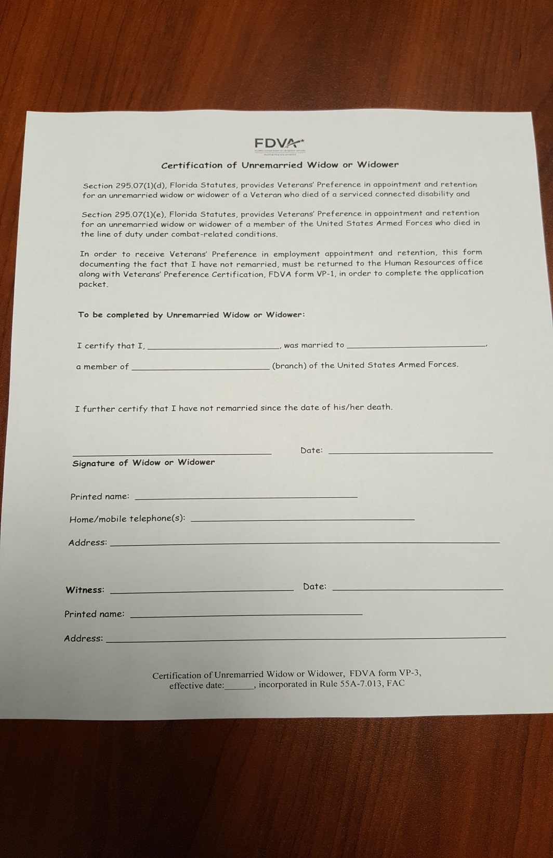

Slide 19
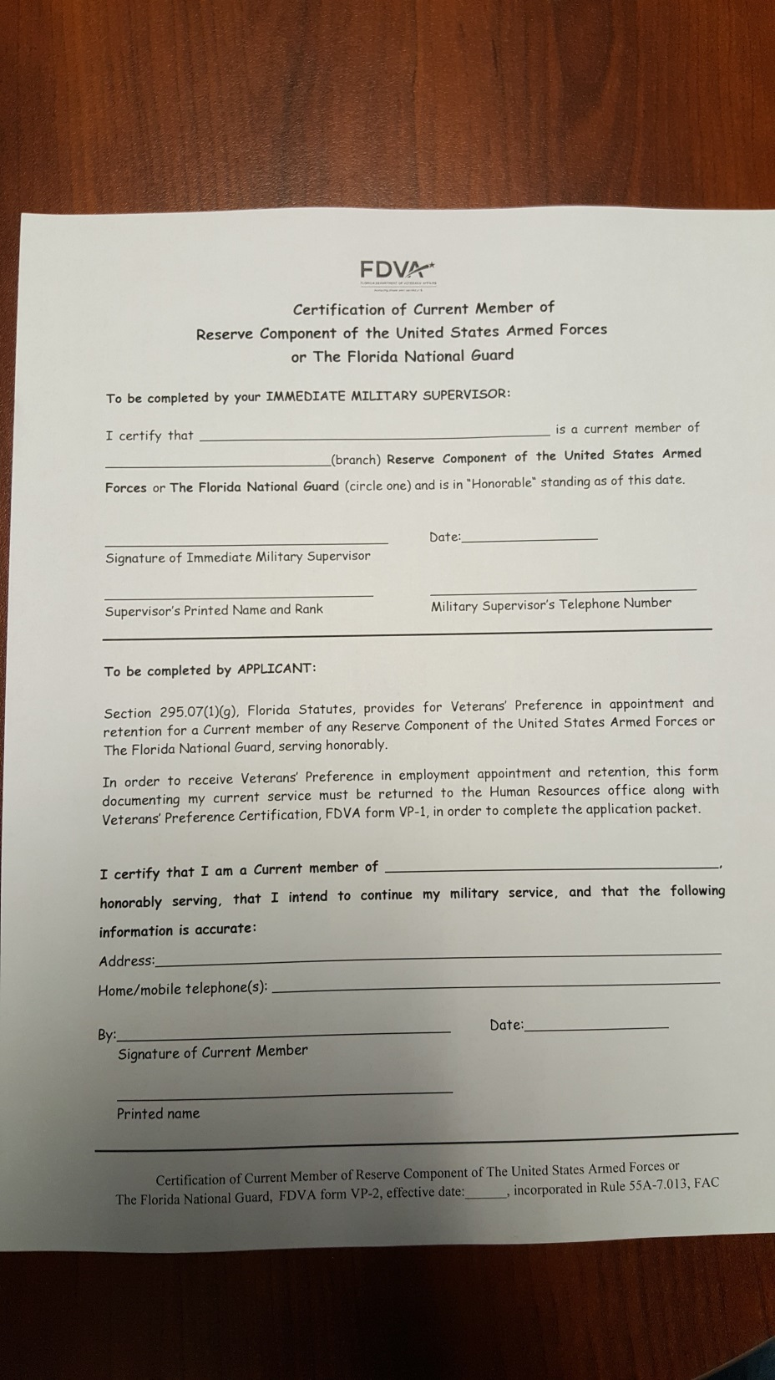

Slide 20
What kind of notice is required for retention?
An employer shall provide NO LESS than 60 days notice to affected employees prior to beginning implementation of a workforce reduction or layoff.
This notice shall describe the different categories of preference eligibility, shall provide a minimum of 30 days to provide documentation of eligibility and designate an appropriate point of contact within the organization to submit the documentation.
If a preference eligible employee is NOT selected for retention, the employer shall notify the applicant within 7 days of the retention decision.

Slide 21
How are preference eligible individuals credited for purposes of a reduction?
Employers shall credit the amount of time the preference eligible employee served on active duty in the US Armed Forces as years of service with the employer for the purposes of determining seniority. Service shall be credited on a year for year and month for month basis.

Slide 22
Additional ways for showing preference for retention…
A numerically-based process may be used.
If a numerically-based process is not used, the employer preference and priority to preference eligible employees as follows:
1) Employees who are not eligible for preference shall be considered first for layoff.
2) If there are no other non-preference eligible employees, then preference eligible employees can be considered for layoff.
3) If two equally qualified VP eligible employees are considered for lay-off, retention shall be awarded based upon the tiers with disabled veterans to be the first retained.

Slide 23
Additional requirements for employers…
Employers are required to document the basis for a hiring decision by maintaining a file that includes documentation of advertised positions, dated advertised, applications received, candidates interviewed, evaluation criteria and methods used such as numerical scoring or other means of evaluating applicants, documentation of manager, team or committee process and interview notes, employment offer and acceptance letters, employment pre-screening results, agreed upon start date for person hired and any other relevant information for the appropriate records retention period.

Slide 24
Continued….
In the event of an investigation the agency or political subdivision shall be required to demonstrate how its employment selection or retention process gave due consideration to VP and the particular preference eligible person at EACH step of the process.

Slide 25
Continued….
When a complaint is filed the DVA will require the agency or political subdivision to provide documentation to support the hiring decision.

Slide 26
The documentation regarding the position shall include at a minimum the following:
Any materials concerning the hiring decision including advertisement of the position, applications of qualified applicants who were considered for the position, interview notes, offers of employment, and acceptance letters any other relevant documentation.
A plain statement justifying the position/selection.
If applicable, a statement as to whether the essential job functions cannot be performed by the preference–eligible applicant. If a statement is provided stating that the applicant can’t perform the job….then another statement must be provided with the type of employment accommodations which were considered and or discussed with the applicant.

Slide 27
What should the applicant do. If they do not hear about the hiring decision?
Prior to filing a complaint, if the applicant has not received notice of a hiring decision:
It is the responsibility of the preference- eligible applicant to contact the HR Department at least one time after 45 days have passed from the final date for submitting an application or the interview date, whichever is later.

Slide 28
Time Requirements
Within 60 calendar days after the receiving a notice of non-select a complainant must file the complaint.
Within 10 days the DVA shall provide a written acknowledgement of receiving the complaint
Within 30 days the employer or hiring authority must provide the DVA with their response. The time clock begins upon receiving the notice of a complaint and that an investigation is taking place.
Within 20 days, if the complaint is found to lack merit the DVA will notify the complainant that they have 20 days from that point to petition PERC for a hearing.

Slide 29
Time Requirements
Within 30 days, if the complaint is found to have merit the DVA will solicit from the employer a statement as to the action the employer proposes to take to resolve the complaint.
Within 15 days of receiving that information, the complainant must notify the DVA of their dissatisfaction with proposed resolution.
Within 10 days of receiving that information from the complainant the DVA shall notify the complainant of their right to petition PERC for a hearing.
Within 45 days of receiving this notice from the DVA, the complainant must petition PERC.

Slide 30
Time Requirements
Within 30 days if the complaint is found to have merit and the employer fails to provide a statement for a proposal to resolve, the DVA will notify the complainant of their non-action.
Within 15 days of this notice the complainant must advise the DVA of their dissatisfaction with the non-action.
Within 10 days of receiving this information from the complainant, the DVA will notify the complainant of their right to petition PERC for a hearing.
Within 45 days the complainant must have petitioned PERC for a hearing.

Slide 31
Levels of review
Florida Department of Veterans’ Affairs
Investigate and review violations of Statute and rules, issue opinions regarding violations and/or mediate cases for favorable resolution
Public Employees Relations Commission
Administrative determination of a Veterans’ Preference complaint and determine penalties for violation of Statute and rules and order remedies.
District Courts of Appeal
Appellate review of decisions made by PERC. They may agree, disagree and agree in part and disagree in part while still being able to determine violations and determine penalties for violation of Statute and rules and order remedies.

